Slide 1

TRAINING
OF
POLLING PERSONNEL
General Elections to WBLA, 2026
March 2026
Office of Chief Electoral Officer, West Bengal

Slide 2
Index
Sl | Subject | Slide
1. | Activities at Distribution Centre | 07 -27
2. | P-1 day at Polling station | 28 - 37
3. | Maintenance Law and order in and around Polling station | 38 - 43
4. | Activities on Poll day | 44 - 84
5. | Voting process | 85 - 108
6. | Some exceptional situations | 109 - 131
7. | Activities at close of poll | 132 - 165
8. | Activities at Receiving centre | 166 - 175
9. | ECINet & Misc | 176 - 177

Slide 3
New instructions
Presiding Officer's Report Format on Poll Day.
Part-I : Mock Poll Certificate
Part-II : Replacement of Power Pack of the Control Unit
Part-Ill : Pressing of Close Button after completion of Poll
Part-IV : EVM/VVPAT replacement Report, if replaced during Mock Poll
Part-V : EVM/VVPAT replacement Report, if replaced during Actual Poll
Collection of Presiding Officer's Report
(i) Part-I, Part-II and Part-III of the Presiding Officer's Report shall he kept in an envelope. Details to be printed on envelope:
  Name of election: (to be pre-printed)
  No. and Name of AC/AS: (to be pre-printed)
  No. and Name of PC: (to be pre-printed)
  Polling Station No: …………..
The Presiding Officer shall deposit the said envelope along with EVM, VVPAT and other election material at Collection Centre.
(ii) Part-IV and Part-V of the Presiding Officer's Report shall be collected by the Sector Officer, whenever any replacement is done. Sector Officers shall submit the said Reports to the Returning Officer.
Alternative document: Unique Disability Identity Card (UDID), Ministry of Social Justice & Empowerment, Govt of India

Slide 4
Use of Strip Seal is discontinued
Design of Pink paper seal for BU is changed.
Design of Green Paper seal is changed.
Use of plastic box for mock poll slips is discontinued. Only the blank envelops containing Mock poll slips have to be sealed with newly designed Pink Paper seal, no plastic box in this regard will be there.
Pr.O’s diary modified
Packeting system of election papers is changed.
PB only at facilitation centre, will not be sent through post office.
EDC procedure remains same.
(Above Changed happened in PGE 2024)
No.464/INST/2023/EPS (Poll Day management outside) date 23.05.2025 – setting up of election booth outside 100 mtr of PS
No.464/INST/EPS/2025/L&O dated 23.05.2025 - arrangement to deposit mobile phones at Polling Station
Use of ECINET app by Pr.O
Photograph of the candidates shall be printed in color (unless the candidate has provided only black and white photograph). The candidate's face should occupy 3l4th of the space in the photograph. PB ballot photo will be black & white as earlier.
Obligatory distribution of 17c to polling agents present, SO to ensure it

Slide 5
New packet arrangement for RC
Packet | Colour | Name of packet | Item no | Content
1st | White | EVM Papers | 3 | 17C, Pr.O report I,II,III and envelop with Mock poll slip
2nd | White | SCRUTINYCOVER | 4 | Pr.O diary, 17A, 14A, Visit sheet
3rd | White | STATUTORY COVERS | 5 | Marked copy, Voter’s slip, used tender ballot &17B, unused tender ballot, Form 14
4th | Yellow | NON-STATUTORY COVERS | 11 | Working copy, Form 10, EDC, Pr.O declaration, receipt book & cash, unused and damaged paper seals and special tags, unused voter’s slip, under age declaration & list, 49MA, ASD declaration, letter to SHO
5th | Brown | as HANDBOOK/MANUAL etc. | 3+ | Handbook, instructions- checklist, do’s & don’ts etc Indelible ink, stamp pad
6th | Blue | OTHER MATERIALS | 5+ | Candidate information booklet, unused forms, Metal seal, Arrow cross mark, Cup of indelible ink
All remaining stationery items should be placed back in the respective transparent Cardboard/Carton containers and submitted at the Receipt Center.

Slide 6
Micro Observer shall specially observe and note:
a.Mock Poll Procedures: To watch the mock poll and see that it is carried out as per the ECI instructions. Votes in CU are cleared and all slips are taken out from VVPAT and put in black envelope, after the mock poll and before the start of actual poll. Mock poll certificate is signed by the Presiding Officer, Polling Agents and all Polling Officers.
b.Sealing of EVM and VVPAT: Before the actual polling and after poll is over.
c.Presence of Polling Agents and observance of ECI instructions with regards to them.
d.The observance of entry passes system and access to Polling Station.
e.Proper identification of electors in accordance with ECI guidelines; identification and recording procedures for the Absentee, Shifted and Dead voter's list (ASD list)
f.Application of indelible ink,
g.Replacement of EVM, VVPAT during mock poll and polling, if any.
h.Noting down particulars of electors and alternative identification documents shown by them in register Form 17A
i.Secrecy of voting, Conduct of polling agents, their complaints, if any, etc.

Slide 7
Activities at Distribution Centre
    1.Arrangement at DC
    2. Tagging of police, cameraman, MO, vehicle
    3. Polling Materials
    4. Receiving EVM/VVPAT
    5. Electoral Roll Checking

Slide 8
Activities at Distribution Centre (DC) on P-1 day
Third Randomization of Micro Observer in presence of the Observers must be completed in time and PS wise list of MO displayed at prominent places at the DC
Checking arrangements at the DC
Strong Room of EVM-VVPATs and other materials;
Arrangements of Distribution Counters;
Space and arrangements for checking of EVMs and Poll materials;
Provision of Training on Demand;
Facilitation Centre for Postal Ballots; medical aid and basic amenities;
Checking attendance of Polling Personnel
Help in grouping of members of Polling Parties;
Familiarize with other members of Polling Parties;
Replacement of absentee Polling Personnel;
All polling personnel must come with Photo I Card which issued to them.

Slide 9
Tagging of Polling Party at Distribution Centre
The Polling Personnel will come to know their respective Polling Station to which they are assigned only at the Dispersal Centre on P-1 day and not before it.
Single window counters – Reporting, issuance of order tagging polling station, distribution all materials including EVMs should preferably be done from one single counter to avoid inconvenience of polling personnel from shuttling between counters.
Large display boards: Decoded list of polling personnel assigning polling stations to be displayed very prominently at multiple places
Reserved personnel are to report at enquiry/PP counter and go to Reserve Shed.

Slide 10
Dispersal Centre to have following arrangements:
Enquiry counter
EDC distribution centre
Large display boards for decoded list of polling stations
ECINet registration- facilitation centres
Polling personnel Cell Counter
Polling station wise Single window counters
Counter for tagging for camera person/videographer for sensitive polling stations
Reporting and waiting area for Micro-observers
Waiting area for reserved polling personnel
Counter for training on demand
Counter for tagging vehicles
Counter for supplying (short) materials
Space for checking of EVMs & materials by polling parties.
xiii) Strong rooms for EVMs and storage of other material.
Medical Aid.
Fire brigade

Slide 11
Activities at DC :
Identification of polling station tagged- From decoding list displayed
ECINet registration- The PRO & PO1 will have to register their mobile number to the assigned phone number
Collection of materials- Material to be collected and checked
Micro Observer/ Videographer- Contact with Micro Observer/ videographer, if deployed
Tagging of vehicle - Movement to the polling station to be made in earmarked vehicle
Tagging of force at police tagging counter
Movement to the polling station with sector force

Slide 12
Checking Polling Materials
EVM এবং VVPAT of your Polling Station
EDC/PB list
Indelible ink
One Marked copy and two Working Copy of E. Roll
Tendered Ballot Paper
Green Paper Seal, Special Tag, Strip Seal, Pink Paper Seal
Alphabetical Roll Locator
ASD and CSV list (if any)
Signature of candidate and Election Agent
Form 17A (Register of Voters), 17C, Pr.O diary, Declaration of Pr.O, Pro’s Report I,II,III, IV, V
Arrow Cross Mark, Metal Seal of Pr.O, Distinguishing Mark
Plastic box for Mock slips
‘MOCK POLL SLIP‘ rubber stamp
Other stationeries

Slide 13
EVM/VVPAT checking
Check address tag of EVM/VVPAT
Candidate Set section of Cu is sealed
Ballot paper is properly fixed in BU
Thumb Wheel of BU is at 1 (If no of candidate including NOTA is less than equal to 16)
Equal number of button of BU as per number of candidate including NOTA is unmasked.

Slide 14
BU is sealed properly
Check with list (EVM/VVPAT, indelible ink, Marked copy, Tendered ballot, Green Paper Seal, Special Tag.
No need to check VVPAT at DC.
No need to switch on before MOCK POLL
Dont keep EVM/VVPAT in unassigned vehicle or unassigned place
Never keep EVM/VVPAT unattended without security

Slide 15
ভোটার তালিকা
ভোটার তালিকাটি integrated হবে, পূর্বের মত তিনটি supplement থাকবে না । তবে SIR, 2026 এ অন্তর্ভুক্ত নতুন নামগুলির পরিবারের সদস্যদের সাথে কোনও বান্ডিলিং এবং পুনরায় সিরিয়ালাইজেশন হবে না।
সর্বশেষ চূড়ান্ত প্রকাশের তারিখ (28.02.2026) থেকে মনোনয়ন দেওয়ার শেষ তারিখ অবধি continuous updation সময় করা সমস্ত সংযোজন রোলের শেষ সিরিয়েল এর পর থেকে ক্রমান্বয়ে serial প্রদান করে ক্রমে রাখা হবে।
প্রকাশিত তালিকায় Deletion/ Correction মার্ক করা থাকবে
# মানে SIR, 26এ সংশোধন হয়েছে
(2)# মানে Continuous updation এ সংশোধন হয়েছে
Latest instruction of ECI/hon’ble Supreme Court to follow

Slide 16
আড়াআড়ি ভাবে DELETED কথাটি মানে SSR এ বিয়োজন হয়েছে।
দুইবার আড়াআড়ি ভাবে DELETED 2 মানে Continuous updation এ বিয়োজন হয়েছে
প্রতিটি Deletion এর পাশে কারণ হিসাবে S / Q/ R / M উল্লেখিত থাকবে (E = Expired, S = Shifted, R = Repeated, Q = Disqualified, M = Missing).
CSV, AIS, ASD এবং ARL তালিকা দেখে নিন
যে সমস্ত ভোটারদের Election Duty Certificate এবং Postal Ballot দেওয়া হয়েছে তাদের নামের পাশে যথাক্রমে ED এবং PB কথাটি লেখা থাকবে এবং পাশে ARO র স্বাক্ষর থাকবে।

Slide 17
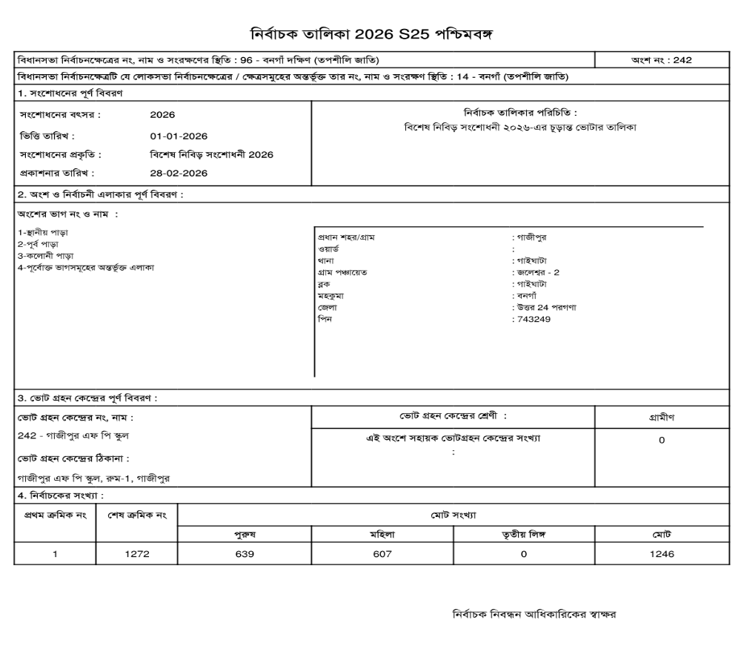

Slide 18
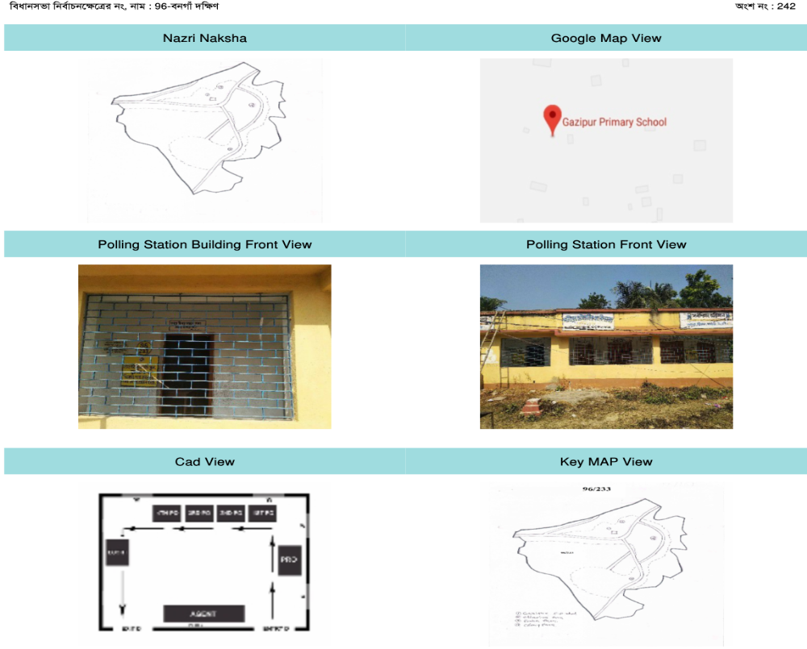

Slide 19
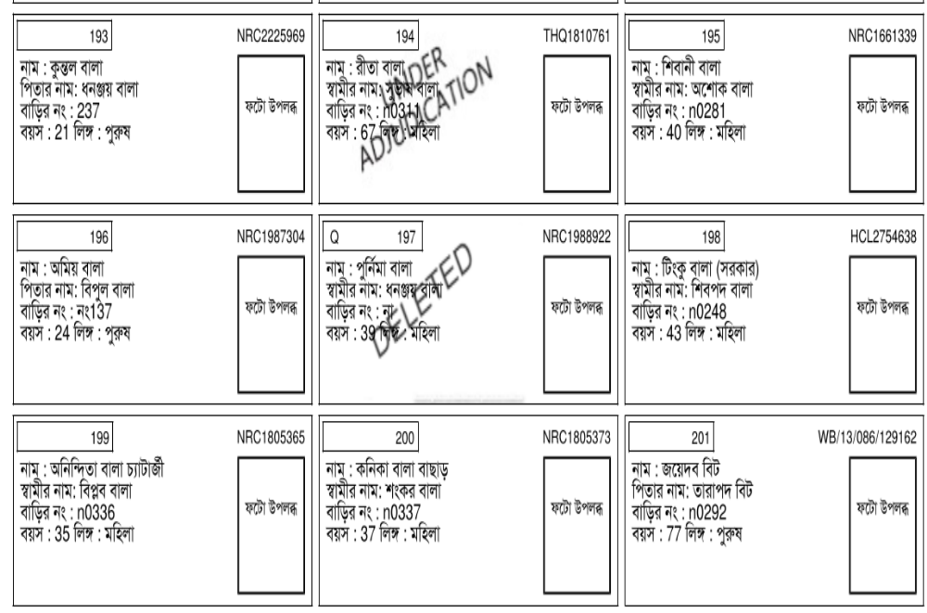

Slide 20
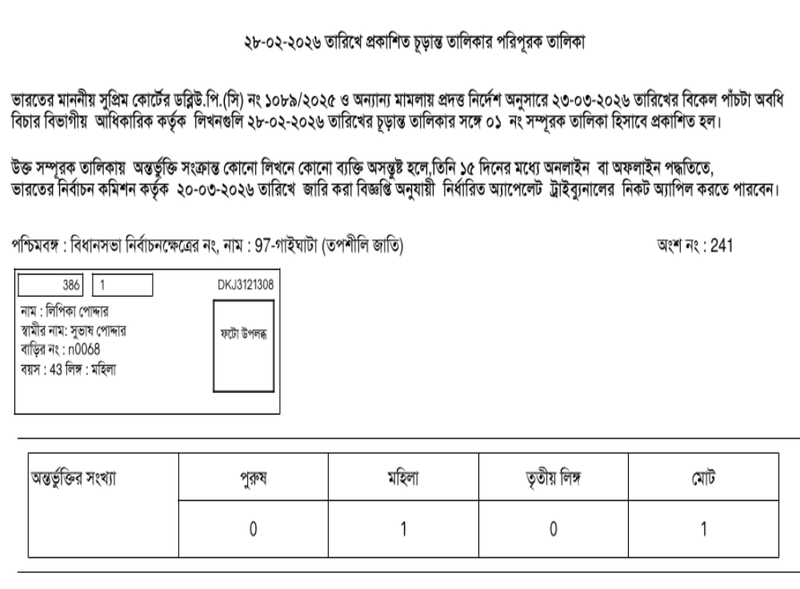

Slide 21
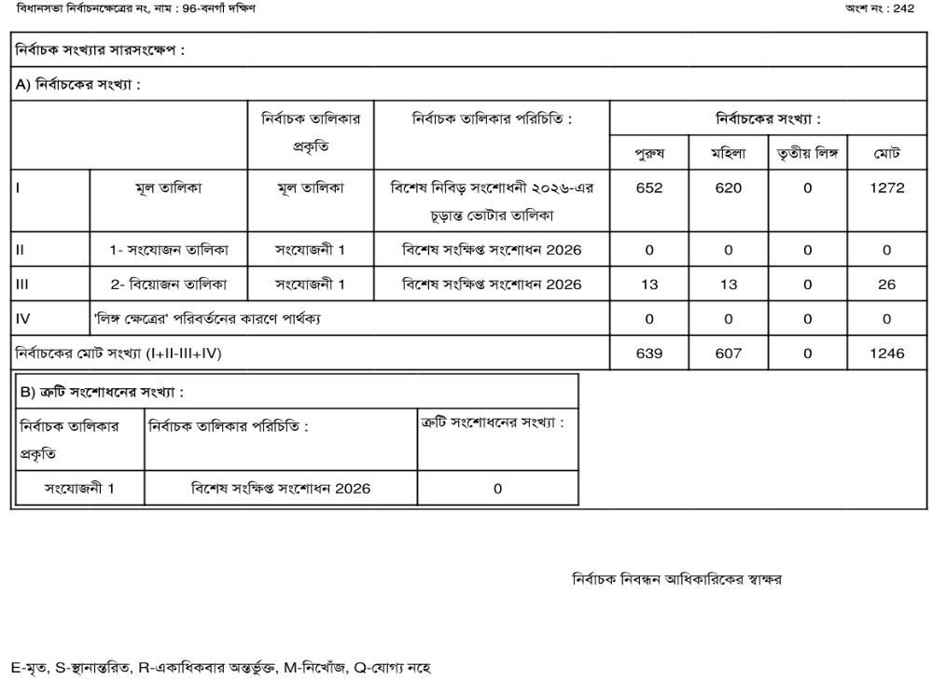

Slide 22
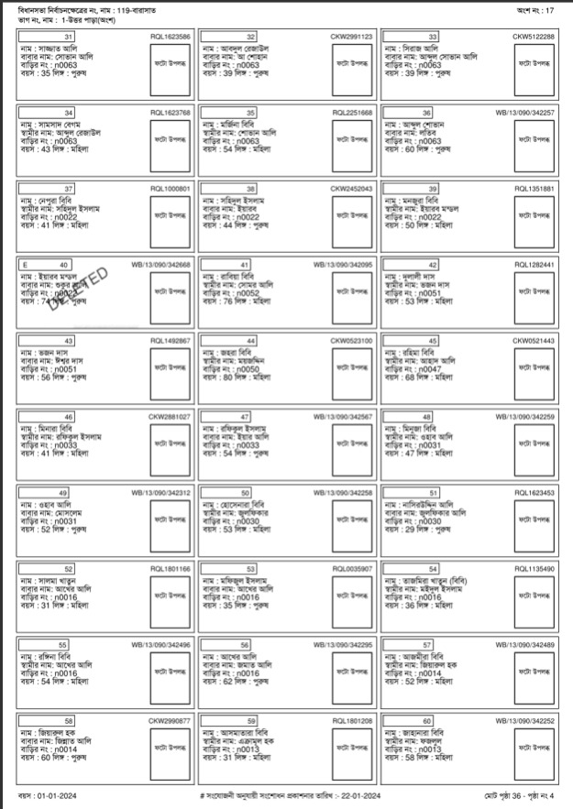
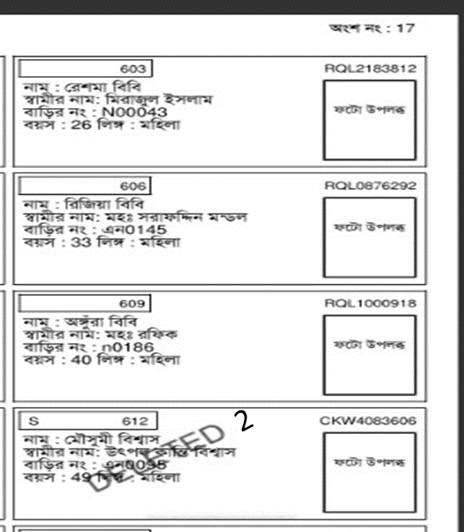
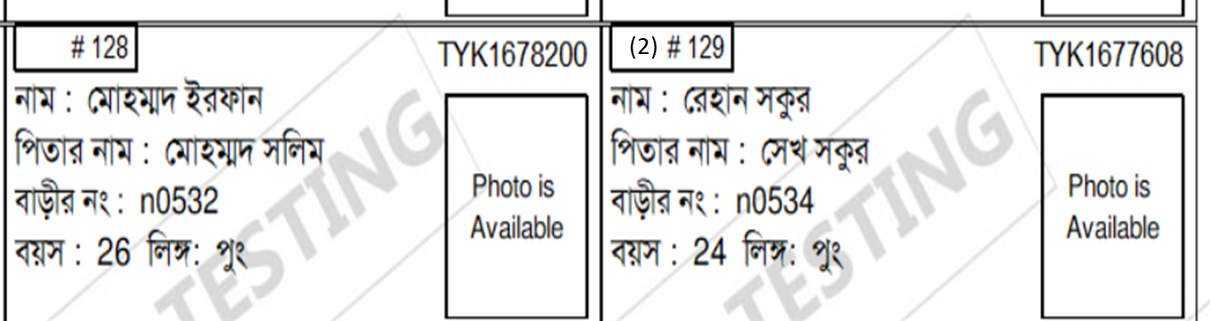
E-Roll for Poll
DELETED- Deletion in SIR
DELETED-2 : Deletion in Continuous updation
# - correction in SIR
(2)# -correction in Continuous updation

Slide 23
যে সমস্ত ভোটারের নামের পাশে PB কথাটি থাকবে তারা আপনার বুথে ভোট দেবে না।
EDC ভোটাররা তাদের যে বুথে নাম রয়েছে সেটি ছাড়া ওই PC র (For Assembly election- AC) যে কোনো বুথে গিয়ে ভোট দিতে পারবে
মার্কড কপি দেখে নিন যে সব অংশ ঠিকআছে
Auxiliary বুথ হলে টপ শিট, মোট নির্বাচক বিবরণ ও তাদের সিরিয়াল নং এর ভাগ মিলিয়ে নিন
মার্কড কপিতে PB/EDCর সংখ্যা’র সাথে আপনাকে দেওয়া PB/ED ভোটারের তালিকা মিলিয়ে নিন
মার্কড কপির প্রতিটা entry authenticate করা আছে কিনা দেখে নিন

Slide 24
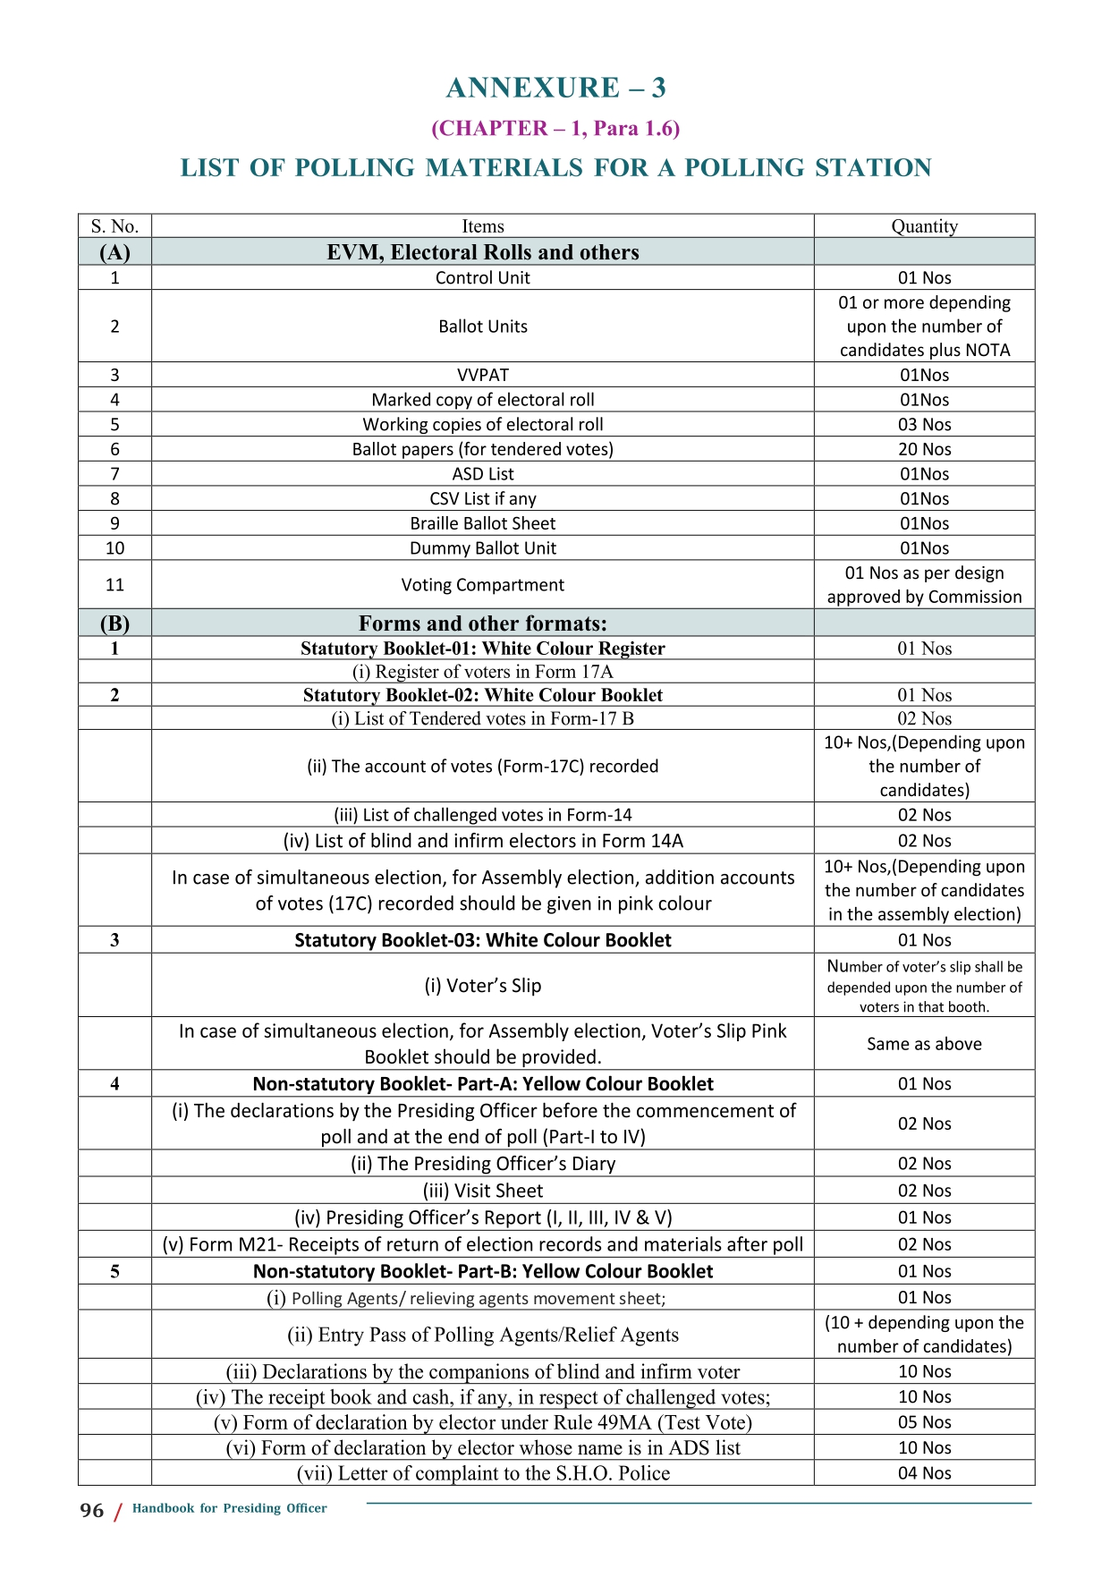
Polling Materials
EVM, E Roll, & others
B. Forms and other formats
C.Envelopes
D.Seals, tags & marks
E.Handbooks and instructions
F. Stationery items

Slide 26
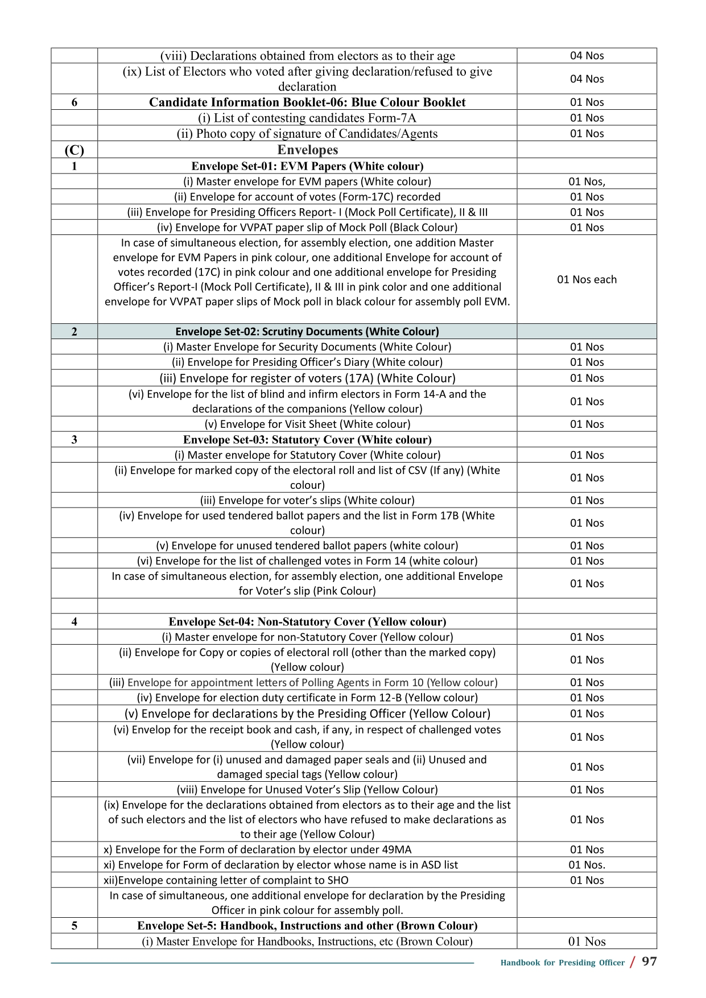

Slide 28
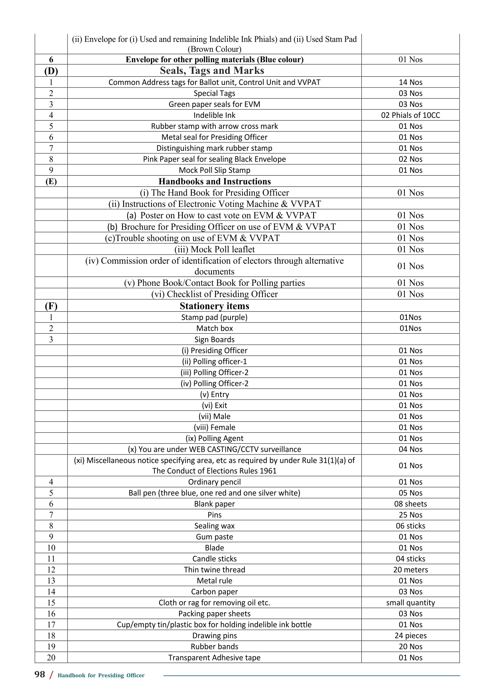

Slide 31
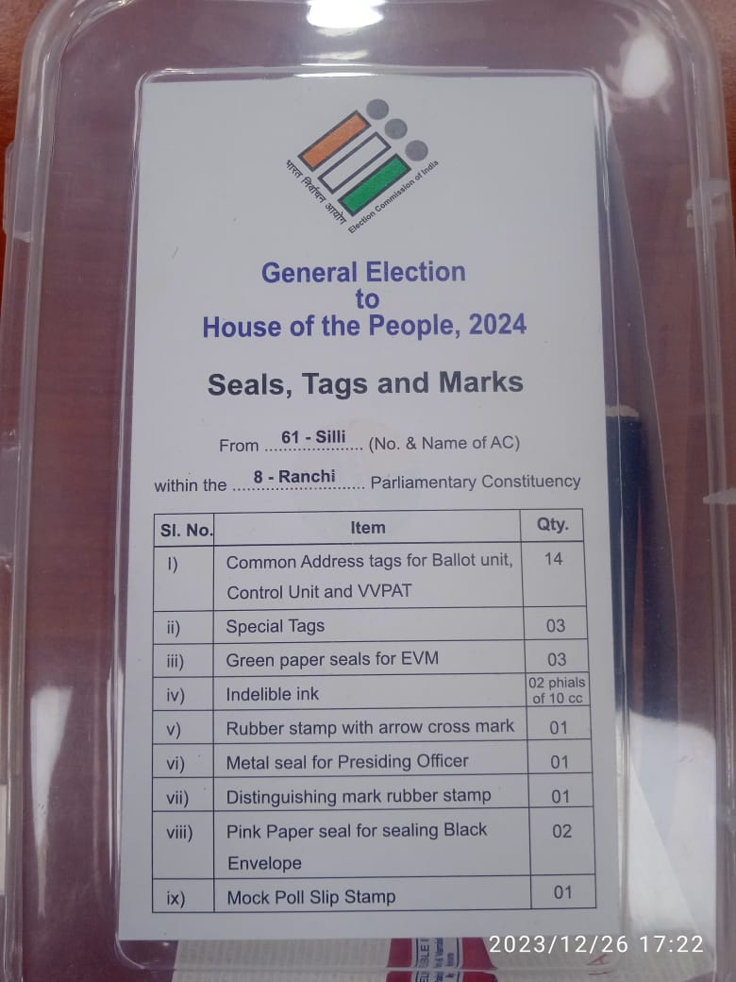
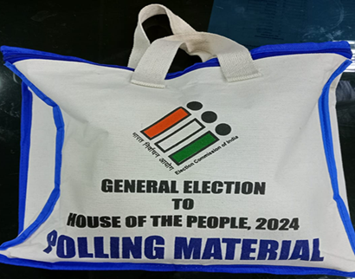
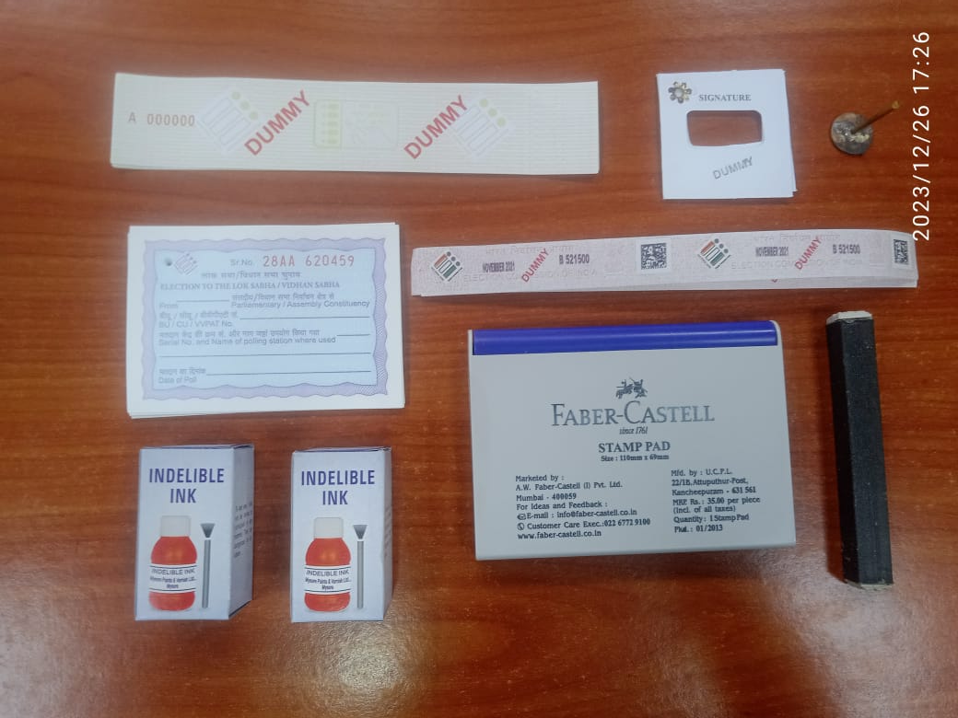

Slide 32
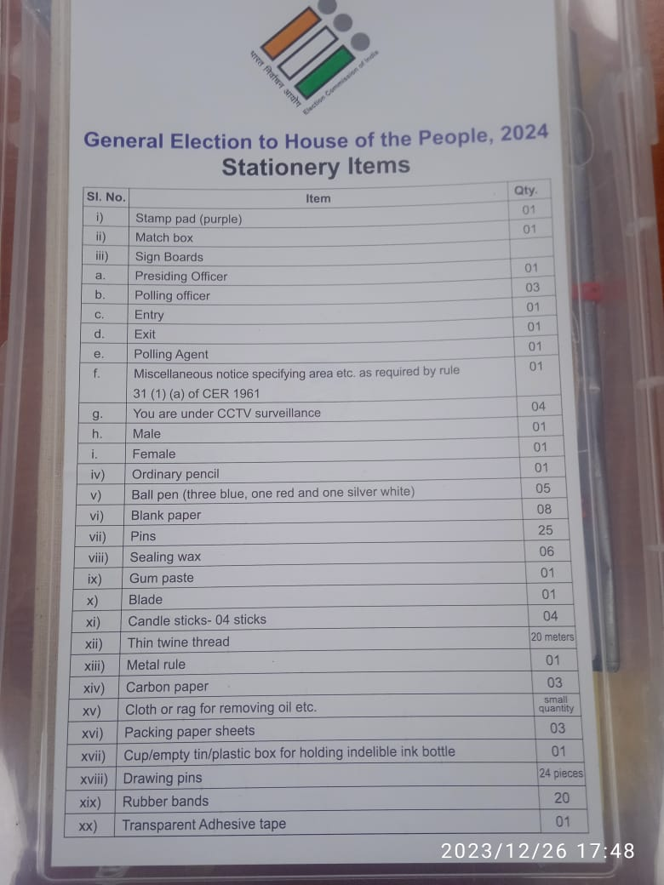
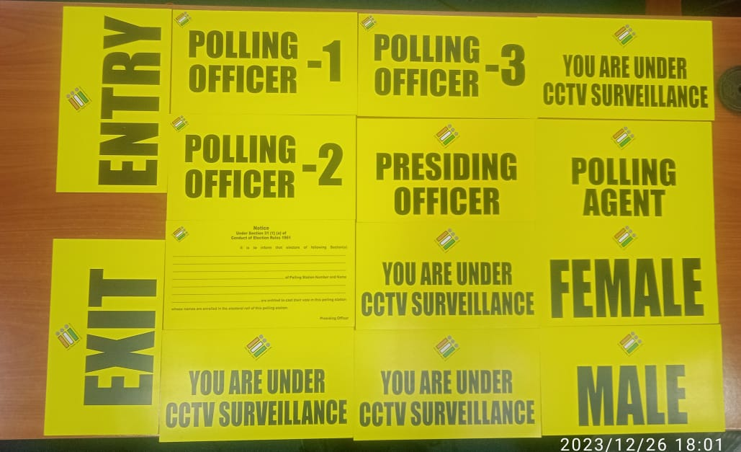
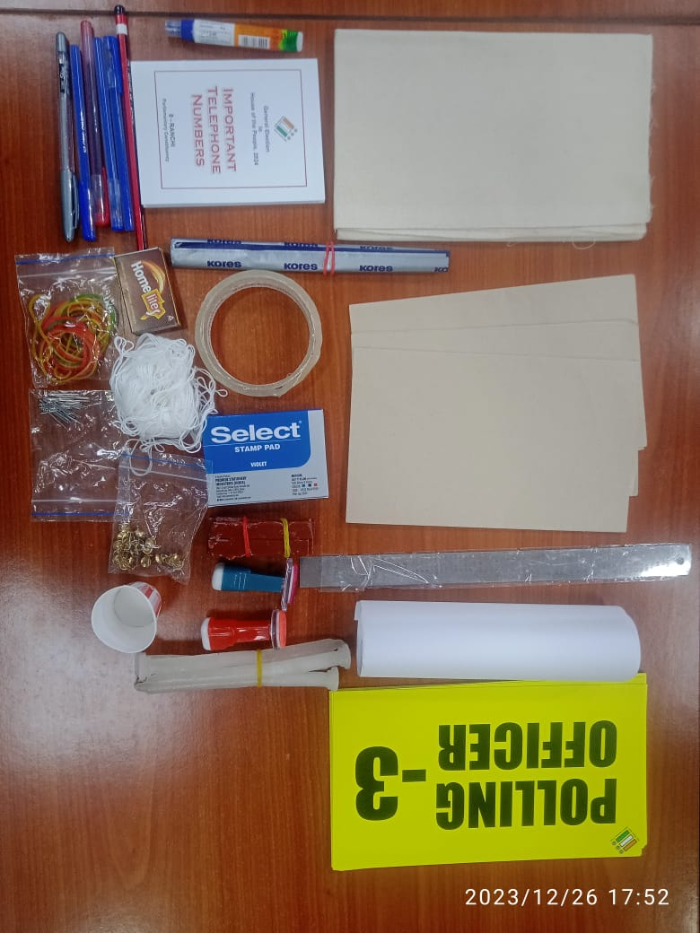

Slide 33
UNDERSTANDING THE ACTIVITIES DONE AT POLLING STATION

Slide 34
Activities done at
Polling Station on
P-1 day

Slide 35
GOING ARMED TO / NEAR A POLLING STATION - contd.
Security personnel attached to any person not to be allowed - Except in case of person covered under Z+ security (one security person in plain Clothes with concealed weapon is allowed)
Prohibition for Minister/MP/MLA to be an election agent, COUNTING AGENT, POLLING AGENT, etc.,
  Any person having security cover will not be allowed to surrender his security cover to act as such agent.
Contd…

Slide 36
PREVENTIVE MEASURES NEAR POLLING BOOTH - contd.
Prohibition of canvassing within PS neighbourhood and conditions to be followed for setting up candidates booth:
No booth to be set up by political parties/candidates within a distance of 100 m from the polling station.
Valid permission from local authority should be obtained Only one table and two chairs at each candidate booth for two occupants who have to be voters in the same polling station area having an EPIC. Persons should not have a criminal record.
Prior permission in writing is to be obtained from the RO.
Such booths can only issue unofficial identity slips.
Only one banner of approved size to display the candidate’s name and party symbol.
Contd…

Slide 37
Prohibition of Canvassing, Loudspeakers, Mega phones etc. and disorderly conduct within 100 mtrs of a PS (S. 131 RPA 1951) - Use of cell phones
No canvassing within PS or any public or private place within a distance of 100 meters of a PS (s. 130)
Amplifying or reproducing the human voice by any apparatus not allowed.
In case of contravention such apparatus to be seized.
Shouting or otherwise acting in disorderly manner not allowed.
Penal action also to be taken.
Use of Cell phones, cordless phone etc., not to be allowed except by the officers on duty in the 100 meters of a PS.
During polling, the PRO and other staff shall keep their mobile "switch off" in the PS. If required they can talk from outside the polling booth.
Contd…

Slide 38
ভোটকেন্দ্রে মোবাইল ফোন জমা দেওয়ার ব্যবস্থা
a) ভোটকেন্দ্রের ১০০ মিটারের মধ্যে মোবাইল ফোন থাকবে কেবল সুইচড অফ মোডে।
b) ভোটকেন্দ্রের প্রবেশপথে ১০ জন ভোটারের জন্য মোবাইল ফোন জমা দেওয়ার সুবিধা প্রদান করা যেতে পারে কারণ সাধারণত যেকোনো সময় সর্বোচ্চ ৪-৫ জন ভোটার ভোটকেন্দ্রের ভেতরে উপস্থিত থাকেন।
c) এর জন্য, ভোটকেন্দ্রের প্রবেশপথে ১০টি খোপ বিশিষ্ট একটি ছোট পায়রার গর্তের বাক্স অথবা ছোট পকেট বিশিষ্ট একটি পাটের ব্যাগ রাখা যেতে পারে।
d) যেকোনো ক্ষেত্রে, কোনও ভোটারকে ভোটকেন্দ্রের ভেতরে মোবাইল ফোন বহন করতে দেওয়া হবে না;
e) জমা দেওয়ার সুবিধা শুধুমাত্র ভোটকেন্দ্রে প্রবেশকারী ভোটারদের জন্য প্রদান করা হবে এবং অন্য কোনও ব্যক্তির (পোলিং এজেন্ট, পোলিং অফিসার ইত্যাদি সহ) জন্য উপলব্ধ থাকবে না।
f ) ১০ জুন ২০২৩ তারিখের নির্দেশ নং ৪৬৪/INST-AMF/২০২২/EPS অনুসারে, ভোটারদের সহায়তা করার জন্য ভোটকেন্দ্রে স্বেচ্ছাসেবকদের মোতায়েন করা হয়েছে। এই স্বেচ্ছাসেবকদের মধ্যে একজন বা দুজনকে বুথ লেভেল অফিসার জমা দেওয়ার সুবিধা পরিচালনার দায়িত্ব দেবেন।
g) ভোটকেন্দ্রের বাইরে মোবাইল ফোন সংগ্রহের দায়িত্বে থাকা স্বেচ্ছাসেবকদের BLO কর্তৃক স্বাক্ষরিত ২'x২' আকারের ১০ (দশ)টি পূর্ব-সংখ্যাযুক্ত কাগজ/কার্ডবোর্ড টোকেনের একটি সেট প্রদান করা হবে।
h) ভোটকেন্দ্রে প্রবেশের আগে, ভোটার জমা দেওয়ার সুবিধায় মোবাইল ফোন জমা দেবেন এবং একটি টোকেন নেবেন।
i) ভোট দেওয়ার পরে এবং ভোটকেন্দ্র থেকে বেরিয়ে আসার পরে, ভোটাররা টোকেন ফেরত দিয়ে মোবাইল ফোনটি ফেরত নেবেন।
j) যদি কোনও ভোটার তার মোবাইল ফোন ফেরত নিতে ভুলে যান, তাহলে ভোট শেষ হওয়ার পরে মোবাইল ফোন সংগ্রহের দায়িত্বে থাকা স্বেচ্ছাসেবকরা এই মোবাইল ফোনগুলি সংশ্লিষ্ট ভোটকেন্দ্রের BLO-এর কাছে হস্তান্তর করবেন। টোকেন প্রদানের পর, বিএলও নিজে সন্তুষ্ট , সেই ভোটারকে মোবাইল ফোনটি ফেরত দেবেন।

Slide 39
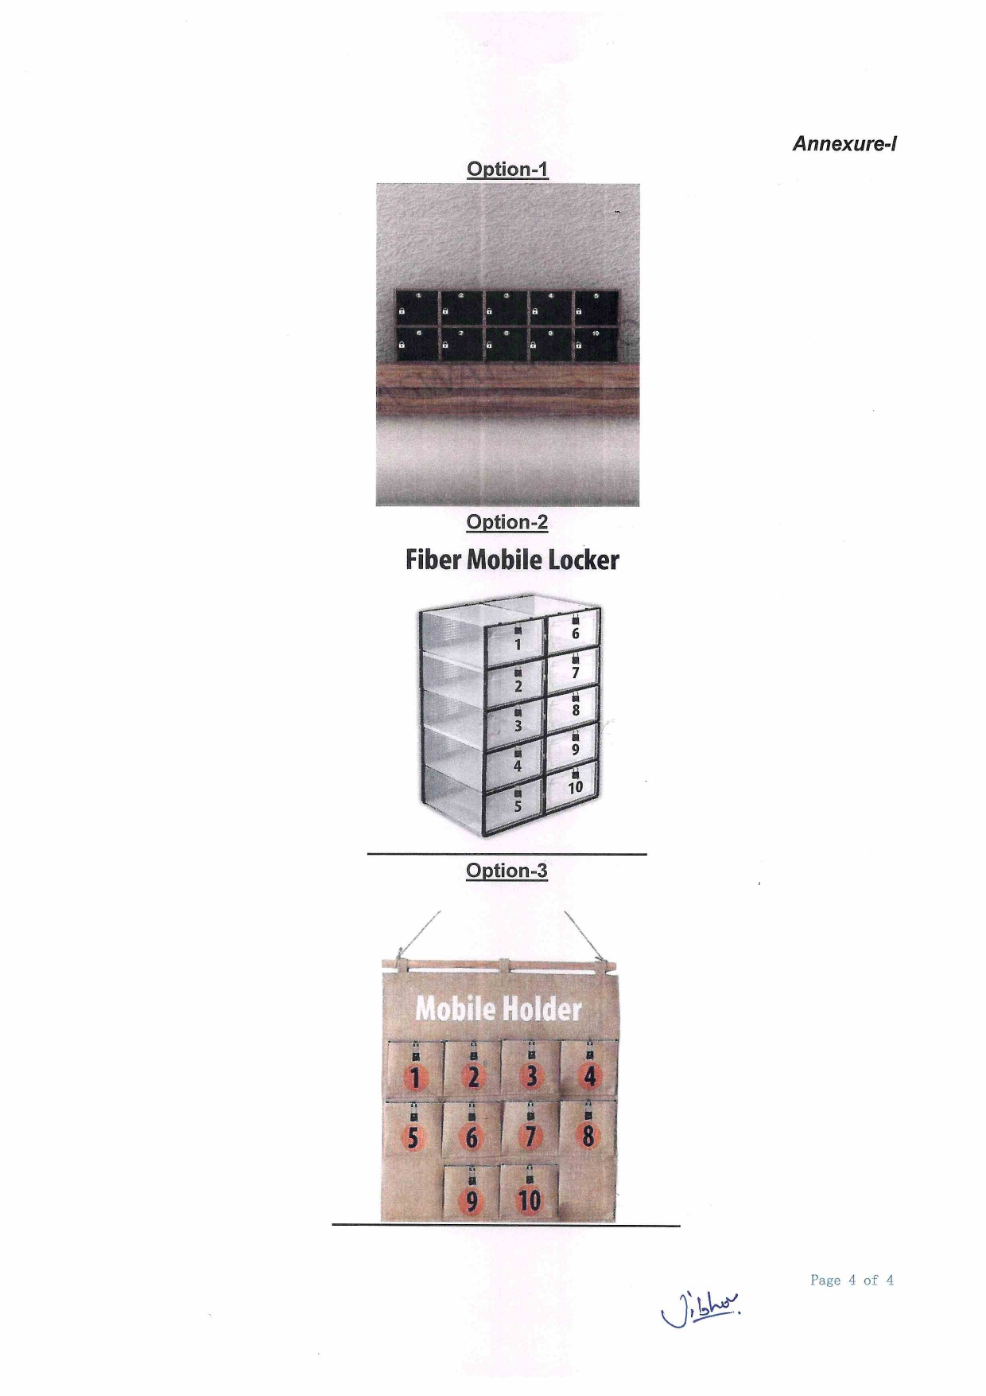

Slide 40
- REGULATION OF PLYING OF VEHICLES ON POLL DAY - contd.
One vehicle each for candidate, election agent and candidate's workers/party workers to be allowed - not more than 5 persons including drivers to be allowed.
If a candidate is absent from the constituency no other person is allowed to use the vehicle allotted to him - No other vehicle should be allowed to be used by any leader.
Permits to be issued by DEO - Permits to be displayed on the windscreen of vehicles
Carrying of voters by these vehicles - Corrupt practice u/s 133 and penal action u/s 123(5) of RP Act, 1951.
There is no prohibition in the following cases:
Govt. Servant on duty, transportation of patient / old / infirm persons, EMERGENCY DUTY VANS AND VEHICLES voters in their own vehicle, public transport and other genuine bona-fide use other than election.
Private vehicles used by owners for themselves/ family members for going to polling booth to vote (not to be allowed within a radius of 200 meter of PS).

Slide 41
  Setting up of Polling Station
  Set up voting compartment at the farthest corner which is secure & secluded for maintenance of secrecy of voting and ensure it is properly lighted.
  The Voting compartment shall be made of corrugated plastic sheet (flex-board) measuring 24“ X24" X 30" " and should not be placed near any window / door;
  CU & BU of EVM & VVPAT to be so positioned that Cable of EVM is not placed on the way of voters
After making proper connections of the BU, CU and VVPA T, the connecting wires may be taped to the leg of the table in such a manner that the wire does not hang in the air so that the load of hanging wire does not impact the connecting switch of the BU and VVPAT and the tape is also easy to remove when replacement of units (BU/CU/VVPAT) are required.
Accordingly, one transparent tape of half inch width has to be provided to the Presiding Officers for the aforementioned purpose. Taping shall only be done using "TRANSPARENT ADHESIVE TAPE" in such a way that taping does not affect the visibility of the connecting wires and it shall be removed easily when replacement of units (BU/CU/VVPAT) are required.

Slide 42
Suitable lighting in voting compartment:
Proper electricity arrangements should be made at the polling stations.
High voltage incandescent bulbs/ tube-light should not be placed over or front of the voting compartment.
Voting Compartment should be placed in such a way that
(a) sufficient light is available inside the voting compartment.
(b) no direct lighting is placed over or in front of the voting compartment.
(c) secrecy of voting is not violated.
(d) voting compartment is not placed near the window/door.

Slide 43
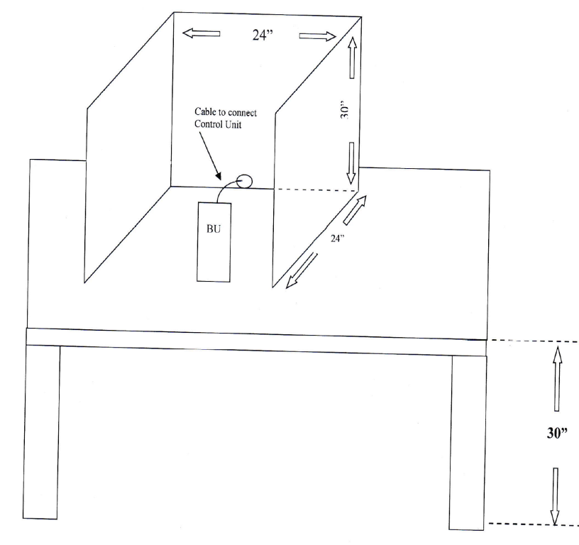
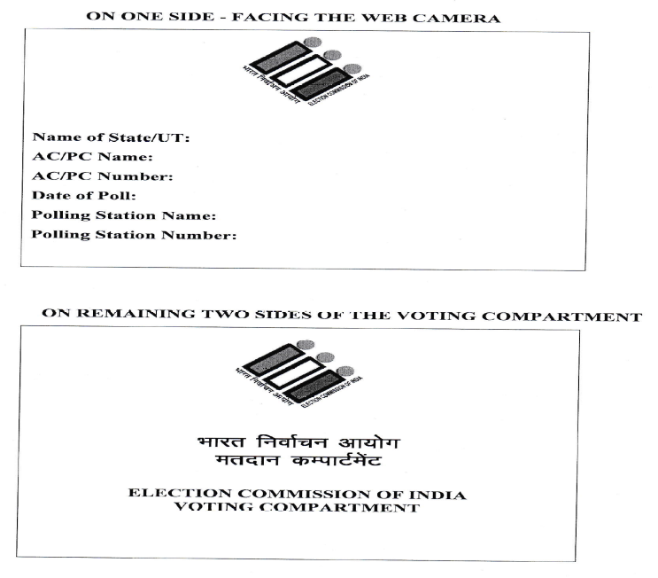
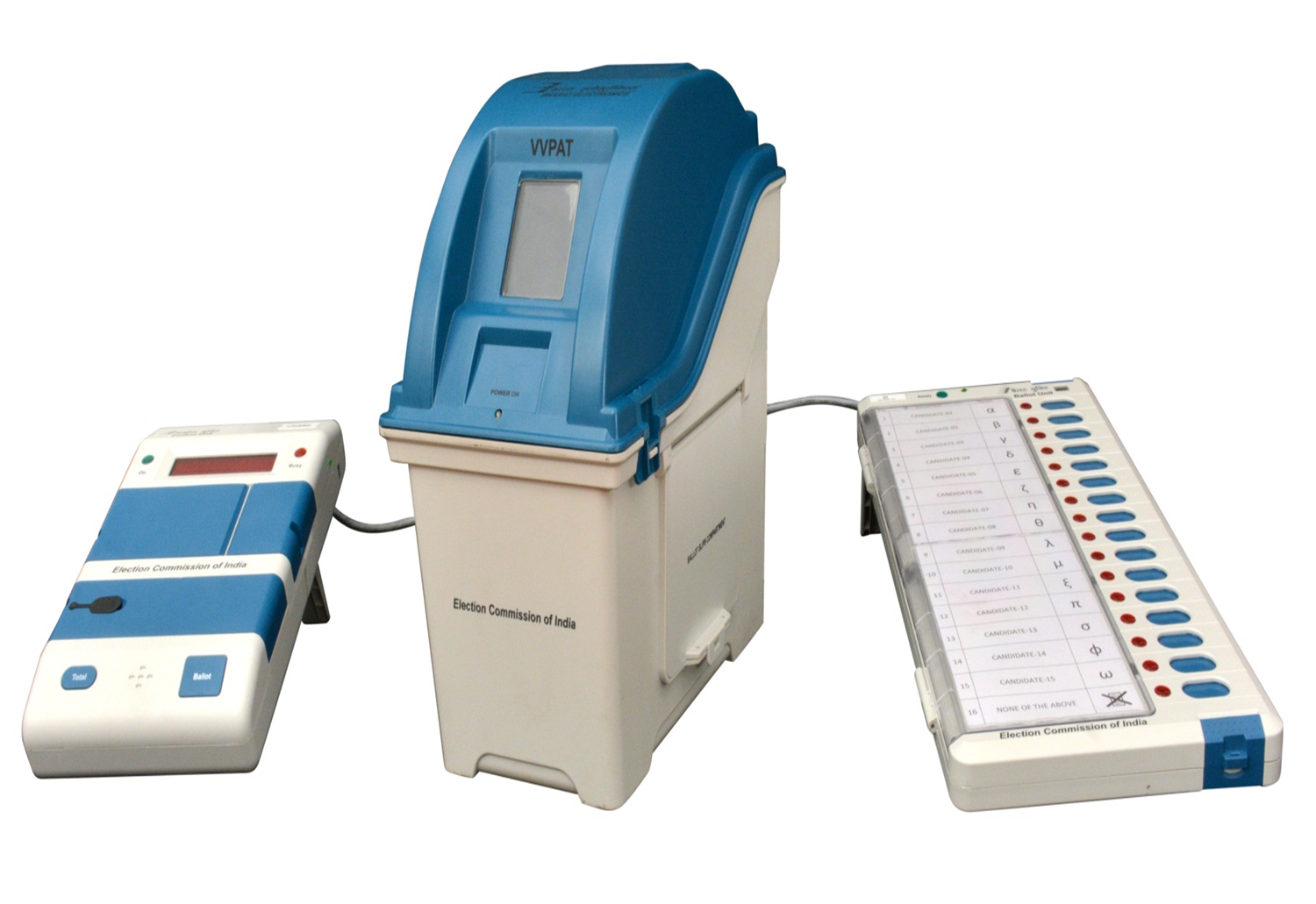
Write PS name, number and other details in the signage of Voting compartment
Position of BU and VVPAT in voting compartment

Slide 44

Activities done on Poll Day
Polling Agents
Mock poll
Pr.O’s Report
Sealing after Mock poll
Reserve identification
CU powerpack change

Slide 45
Activities On the Day Of Poll: Preliminaries
Start Preliminary Activities at least 90 minutes prior to the scheduled hours of Commencement of Poll ;
Display Photo Identity Cards.
Place the phials of indelible Ink carefully in order to avoid spilling over;
Also take note that other prerequisites namely EVM, copies of Photo Electoral Rolls, Voters’ Register(17 A), pass for Polling Agents etc are firmly in place, along with Micro Observers and Digital Photographers, if so designated;
Allow Polling Agents enter Polling Stations. Verify signatures of Candidates/ Election Agents in the Appointment letters (Form 10) of the Polling Agents in reference to Specimen Signatures of Candidates/ Election Agents given at the Distribution Centre.

Slide 46
Conditions for polling agent
Must be a voter of that Assembly Constituency.
Must be appointed by the candidate/election agent through prescribed form ( Form no 10) only.
Seating arrangement to follow the sequence of candidates belonging to national recognised /state recognised /registered/independent
Two relievers may also be engaged in like manner, their movement to be controlled through issuance of Gate Passes and due signature on Movement Sheet.
One polling agent to remain seated in the polling station at a time.
Substitution of reliever is not allowed after 3 pm .

Slide 47
Ministers/ MPs/ MLAs/ persons to whom security cover is given, cannot become election/polling/ counting agents: he is not allowed to relinquish security cover to become agents;
Copy of the electoral roll as marked by the polling agents can not be taken outside the polling station.
Under no circumstances, the agents can be allowed to send slips outside indicating the Serial Numbers of the voters who have voted or not voted.
Can display a badge showing the name of the candidate only.

Slide 48
Mock Poll
Should start 90 minutes prior to the poll.
If no polling agent arrives or only one agent is present wait for 15 min. If none else appears even after that, mock poll to be started. In such cases the matter is to be recorded in the mock poll certificate to be prepared after mock poll.
Connect BU with VVPAT and VVPAT with CU.
BU, VVPAT and CU to be placed in the same position as will be done during poll.
Put paper roll knob of VVPAT in vertical (unlocked) position
Switch ON the CU.
Press TOTAL button and show that no vote is recorded in EVM
Press BALLOT button and ask any polling agent to press his candidate’s button in BU
At least 50 votes in total and 1 vote shall be cast against all buttons including NOTA and record maintained.

Slide 49
Press CLOSE Button At the end of casting votes in Mock Poll,
Press RESULT button and show the result of Mock Poll
Press CLEAR button & clear the data of Mock Poll by and show that the EVM has no data recorded in it.
Press “Total” button to ensure that there are no votes recorded in CU before the actual poll.
Send Mock poll completion sms
Prepare Pr.O’s report Part I in format in duplicate and sign. Obtain signatures of polling agents present, (if absent record the same) and MO (if deployed). Sector officers to collect one copy, other copy to be submitted at RC.
Entire mock poll process should be videographed where ever vidography arrangement has been made at the polling station

Slide 50
Sealing of Mock poll slips and preparation of VVPAT
After mock poll, all ‘printed paper slips’ will be taken out , marked with a stamp on their back as ‘MOCK POLL SLIP” (dimension of the stamp 3cms x 1.5 cms) kept in a black envelope
PrO and polling agents to sign on the envelope marked as ‘VVPAT paper slips of mock poll’
The envelope will then be put in a plastic box and sealed with Pink Paper Seal.
No. And name of PS, Name of AC and date of poll to be written on plastic box
The cover of Drop Box will also be sealed and attached with address tag.
51/8/7/2019-EMPS dtd 08.05.2019 - The Commission has further directed that any deviation in compliance of the aforesaid mock poll instructions shall be viewed seriously by the Commission and the District Election Officer shall take suo-moto disciplinary action against defaulting Presiding Officers. Sector Officers shall be responsible to ensure these instructions are clearly understood by all Presiding Officers.

Slide 51
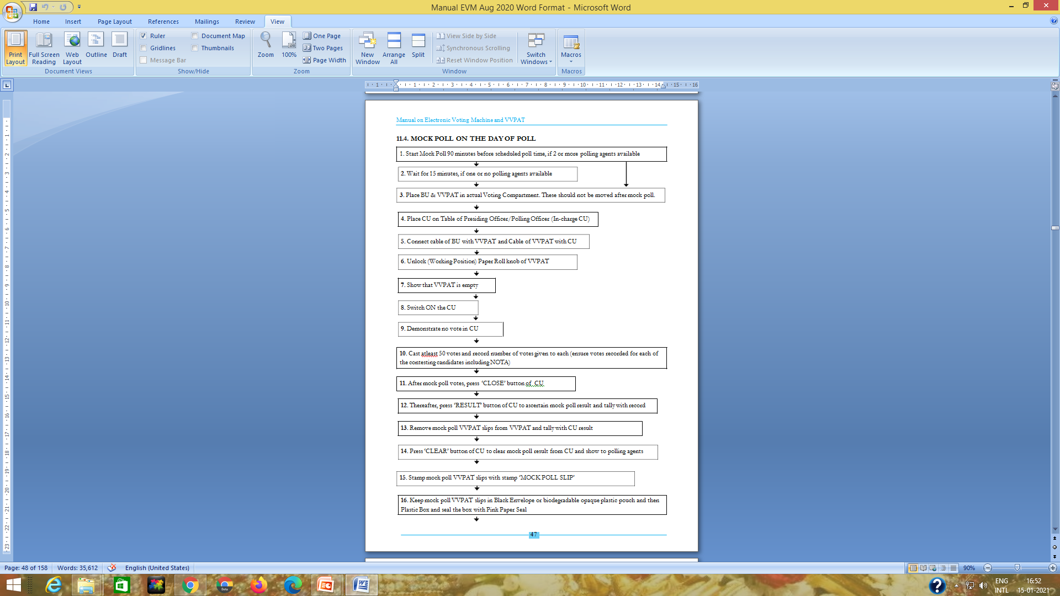

Slide 52
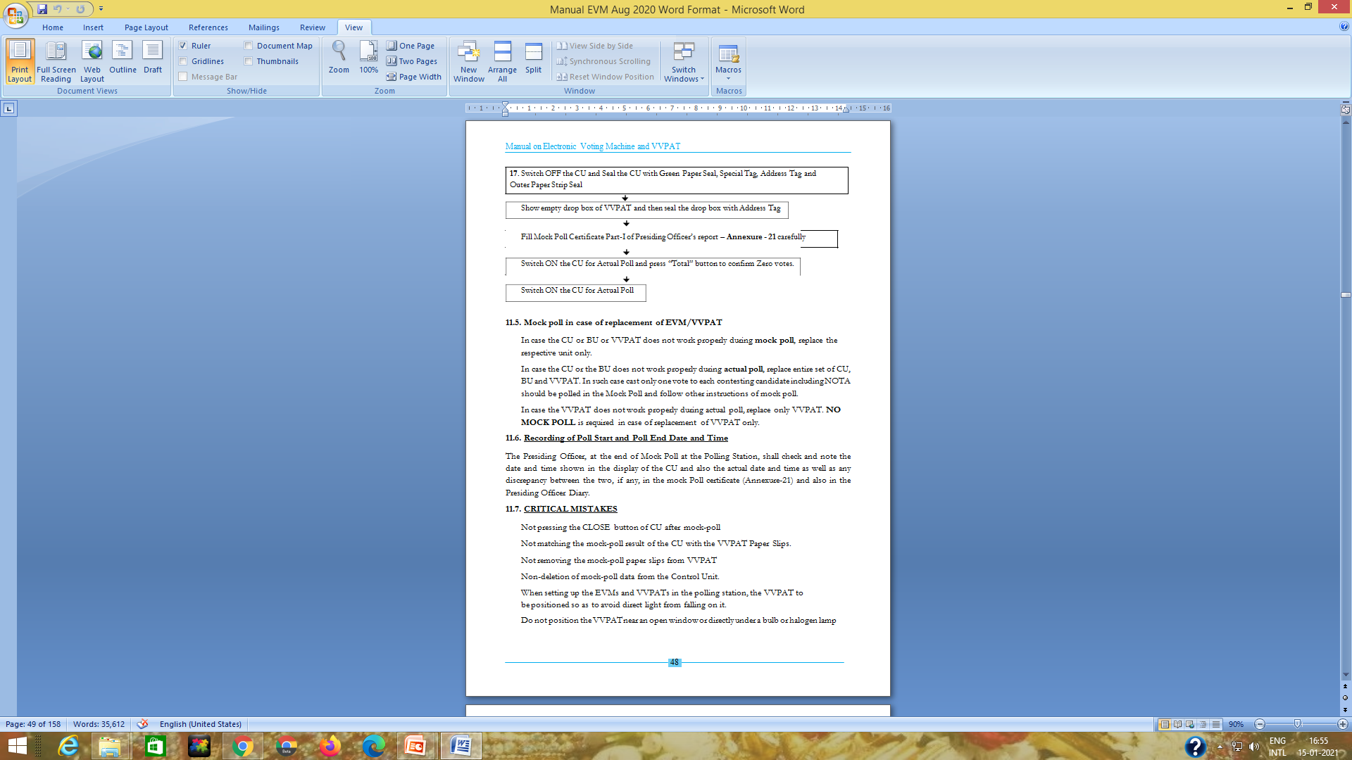

Slide 53
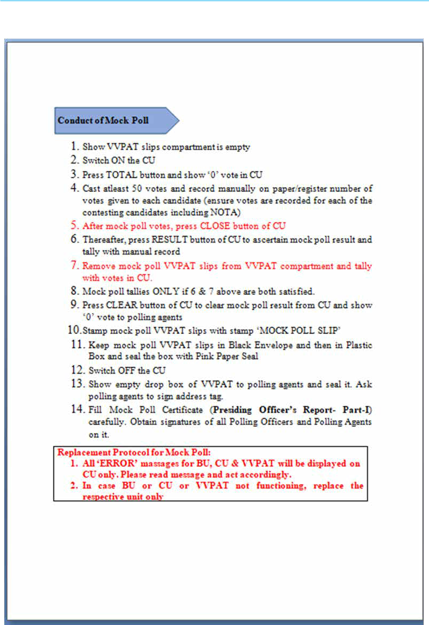

Slide 54
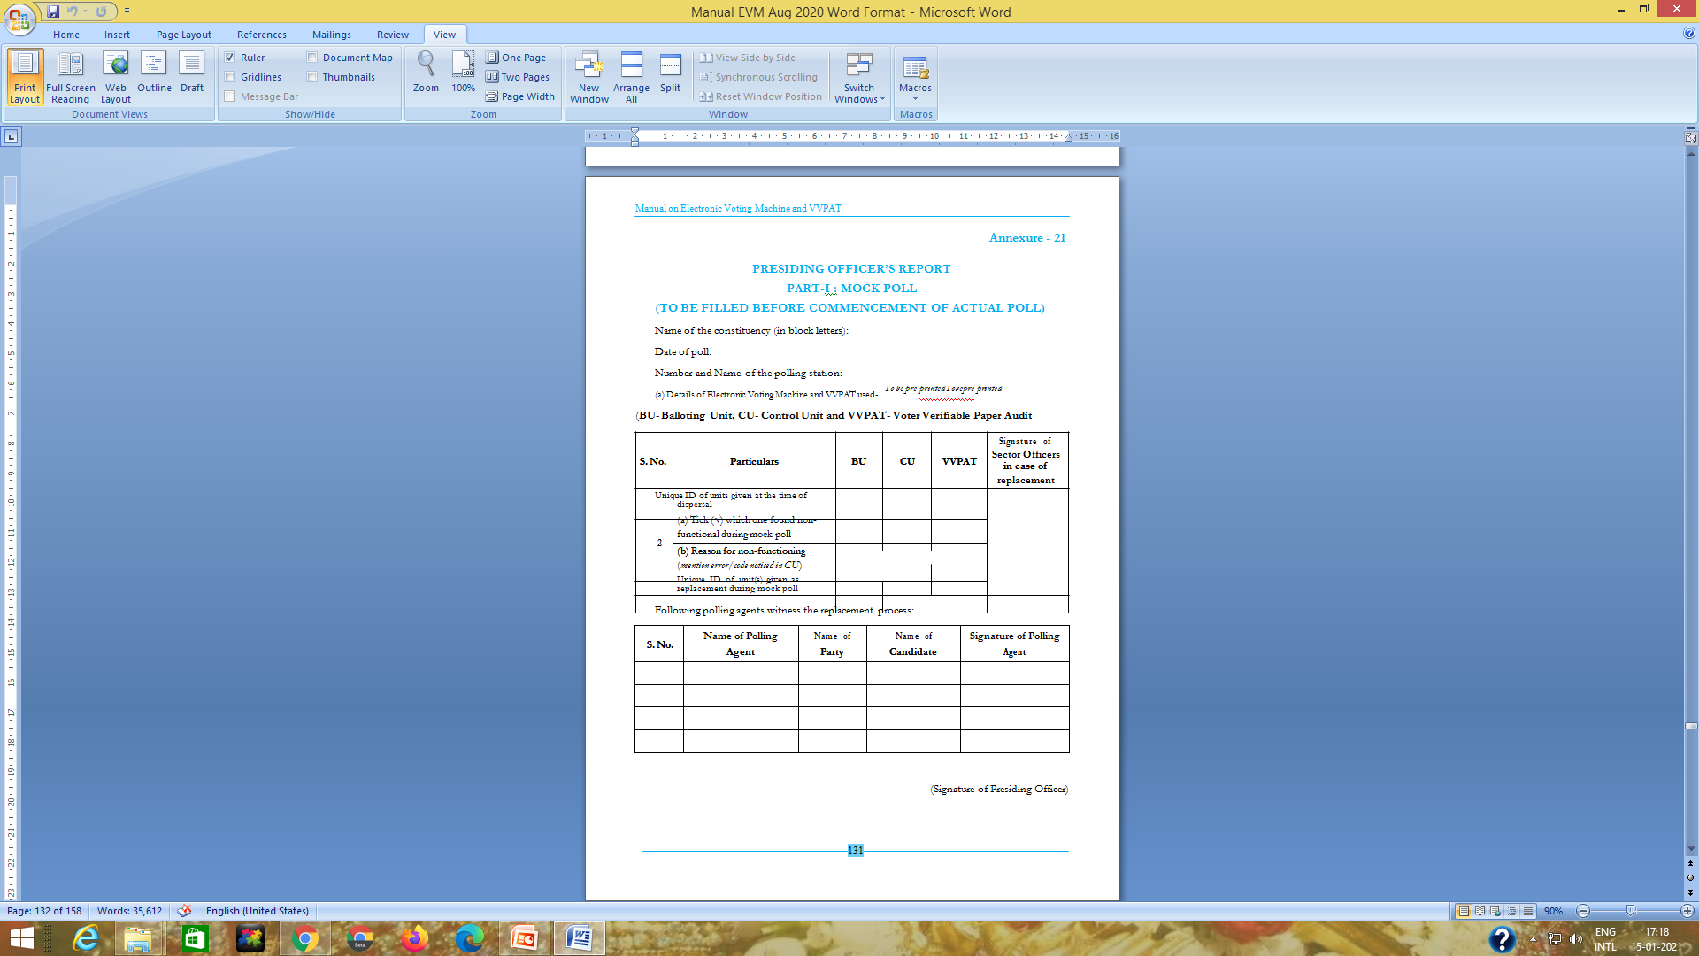

Slide 55
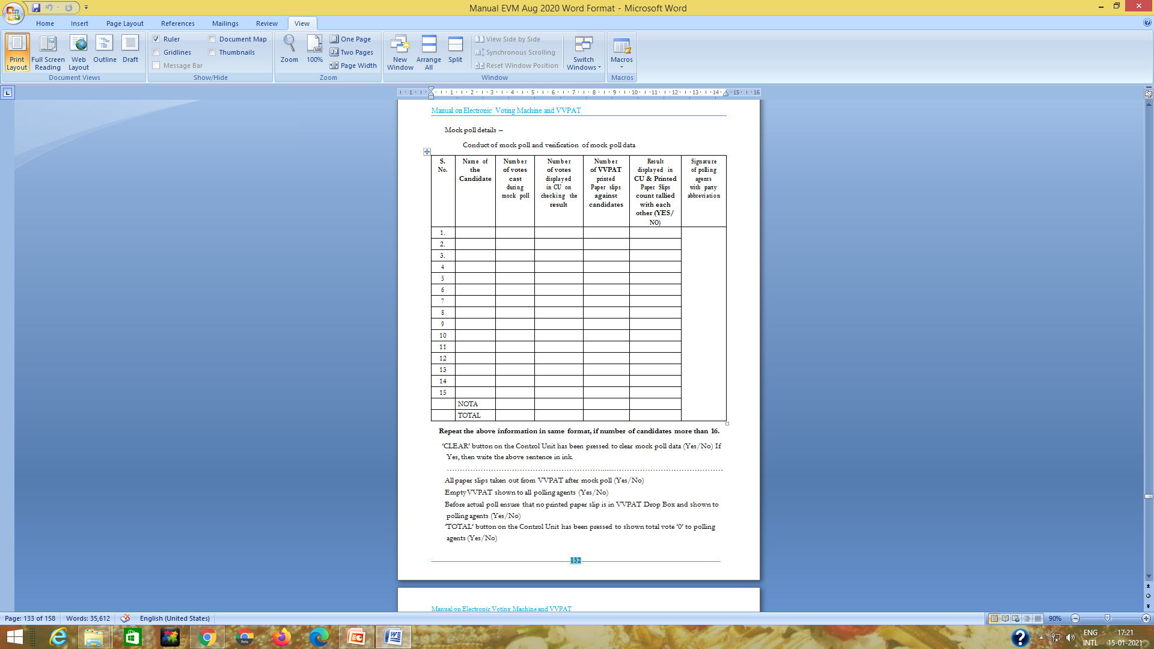

Slide 56
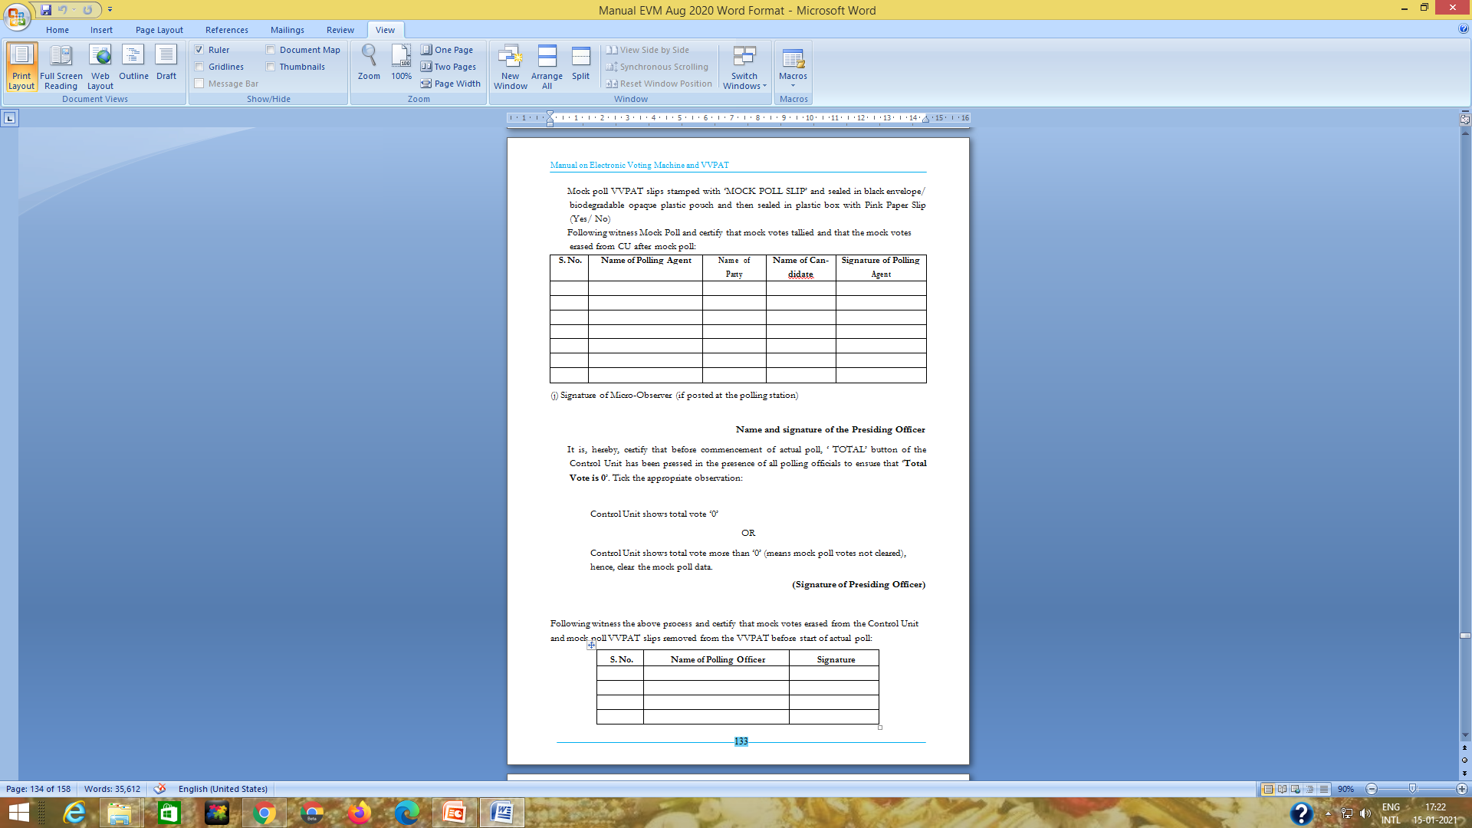

Slide 57
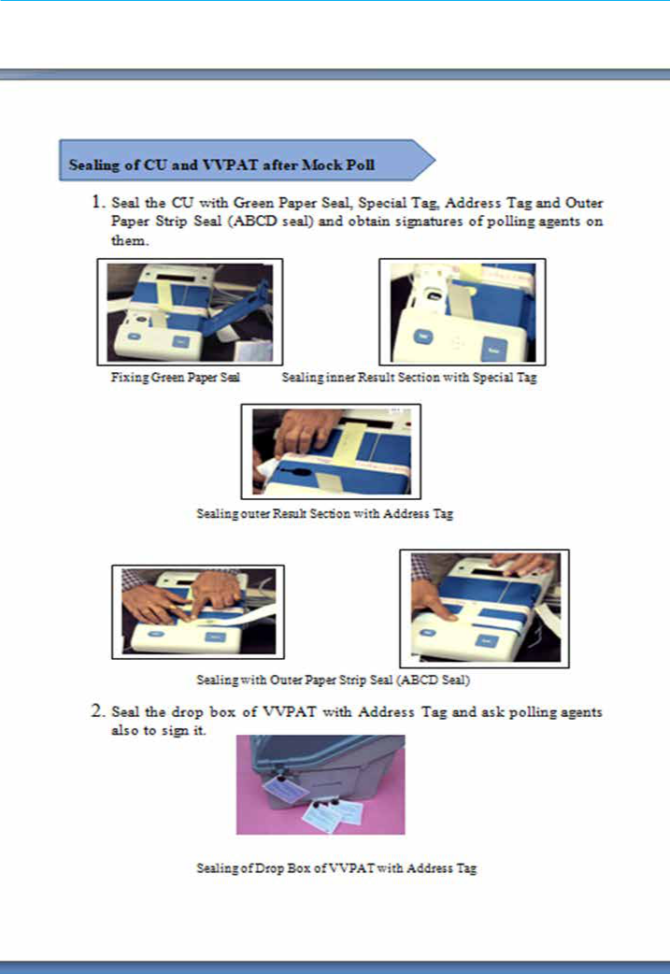

Slide 58
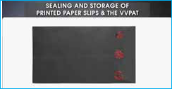
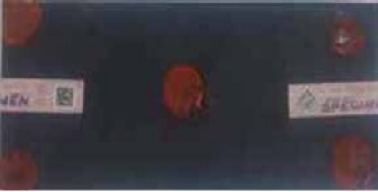
Sealing of Envelope having mock poll printed ballot slips with Pink Paper Seal
After the mock poll, Presiding Officer removes all the printed paper (ballot) slips from the drop box in the VVPAT unit, stamps the printed paper slips of the mock poll on their back side with rubber stamp having inscription “MOCK POLL SLIP’ before keeping and sealing these printed paper slips in the thick black envelope supplied for the purpose. The envelope is sealed with the seal of the PO.
Seal the envelope with a Pink Paper Seal placed all around in such a manner that opening of the envelope shall not be possible without breaking the seal.

Slide 59
CLOSING AND SEALING C.U.
FIXING OF GREEN PAPER SEAL:
Switch off CU and detach from the cable.
Pr.O to sign in full on white side of paper seal just below the Sl.No. of paper seal
Get also signatures of agents present
Insert paper seal through the frame of inner door of Result Section so that green side is seen through the two apertures
Door of inner compartment should be closed by pressing so that two open ends of seal project outward
Prepare A/C of paper seal in 17C Part-I and return unused & damaged paper seals to RO and relevant part in P.Os Diary

Slide 60
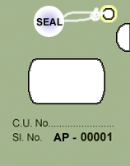

EVM – Seals/Tags used
Election To: (Lok Sabha or Legislative Assembly)
From: (No. and Name of)
Constituency
Control Unit/ Balloting Unit No.: (ID number)
Serial No. & Name of
Polling Station Where Used ……..…….… …
Date of Poll:………………………………………
Address tag with sealing thread
Green Paper seal for sealing Result and Print windows
Front
Rear
Special tag for sealing Result section inner compartment

Slide 61
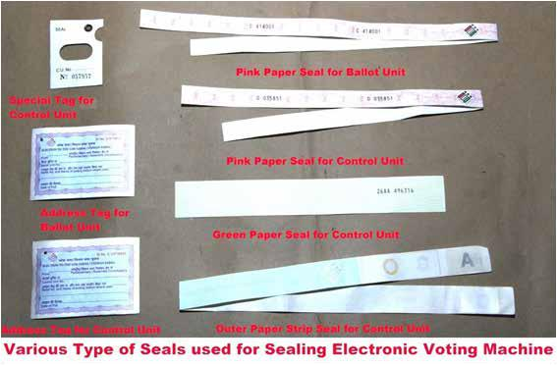
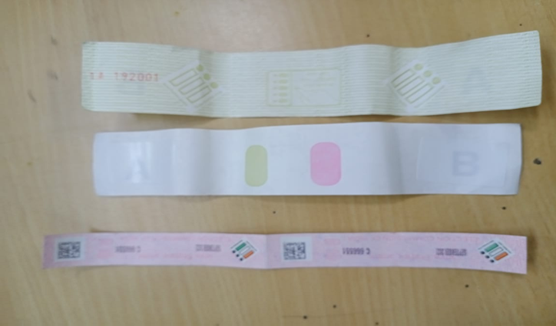
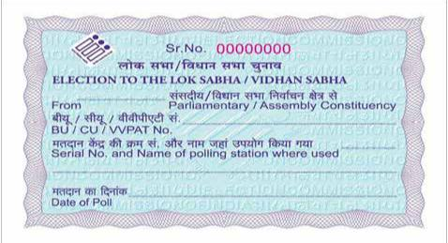
VARIOUS TYPES OF SEALS USED FOR SEALING EVMs & VVPATs
Green Paper Seal
Special tag
Common Address Tag for BU/CU/VVPAT
for sealing Result section inner compartment
Pink Paper Seal

Slide 62
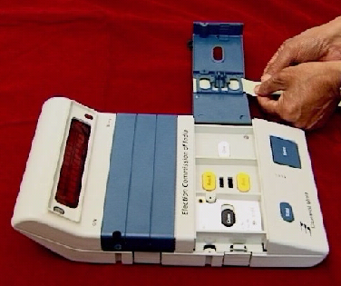
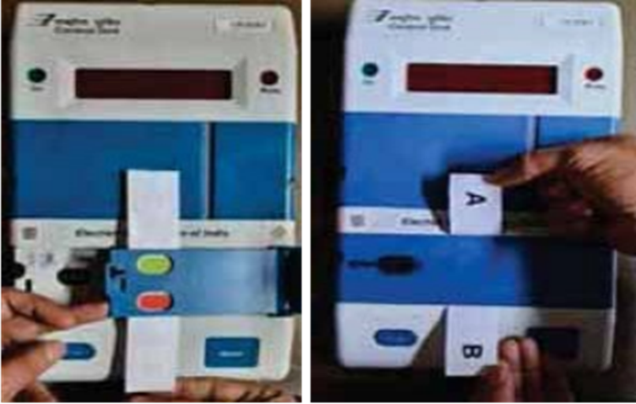
EVM – Sealing
Insert the Green Paper seal in the frames provided for both Result
Close the Result Section inner compartment door with the Green paper seal protruding outside

Slide 63
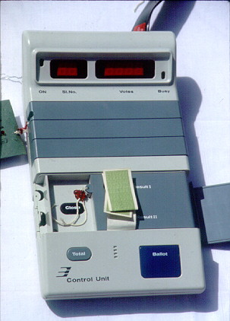
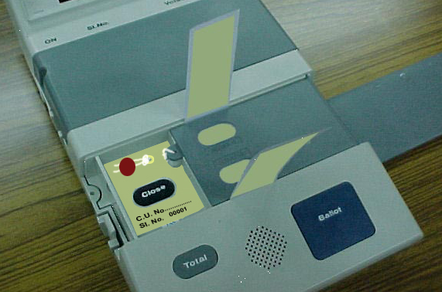
EVM – Sealing – Presiding Officer
Seal the Result Section inner compartment
Fix the Special tag such that the button is visible and seal the tag
Close

Slide 64
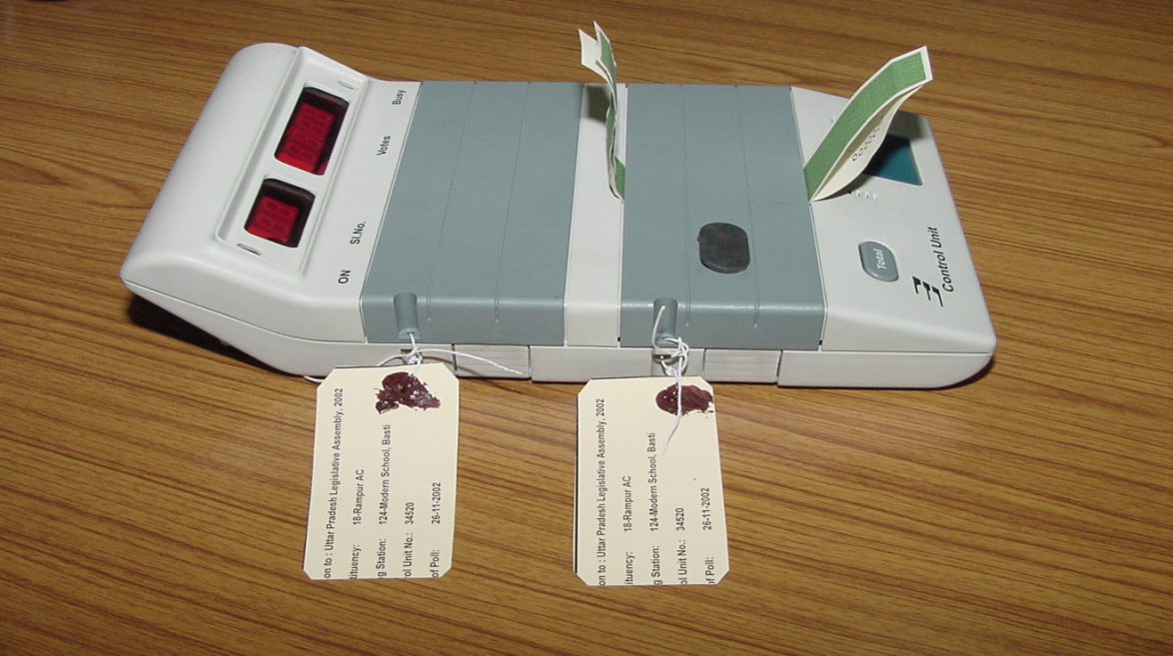
EVM – Sealing – Presiding Officer
Close the Result Section door such that the Green paper seal protrudes outside and Seal the door along with the Address tag

Slide 65
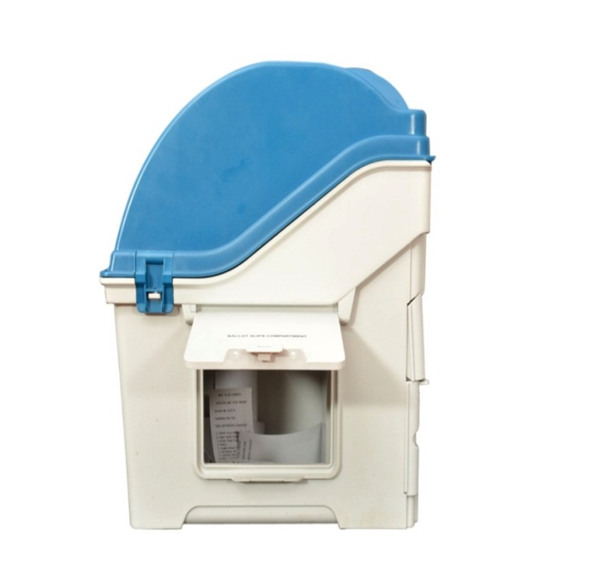
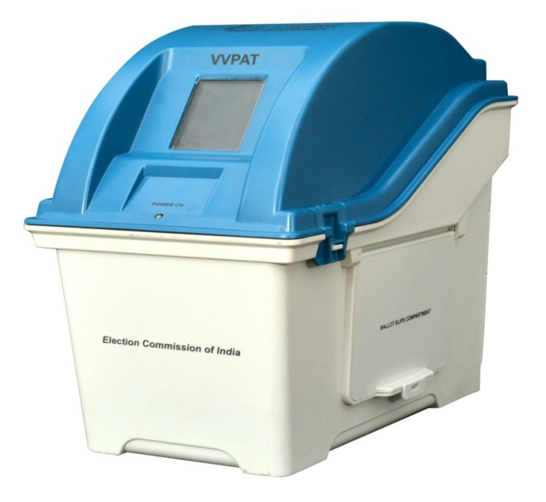
Presiding Officer and polling agents shall put their signatures on the address tag used for Sealing Drop box of the VVPAT after completion of mock poll.
VVPAT Sealing
Remove all Ballot Slips from Ballot Slip compartment and Keep in Black Envelope and Plastic Box.Seal with PPS.
Now Actual Poll may be started.

Slide 66
Identification of reserve EVMs and VVPATs
For visual identification of reserve EVMs and VVPATs the following shall be strictly, followed:
1. Adhesive Stickers with inscription 'RESERVE' shall be pasted on the carrying cases
of reserve BUs, CUs and VVPATs during commissioning of EVMs and VVPATs.
2. Apart from the adhesive stickers" the carrying cases of reserve EVMs and VVPAT's shall also be sealed with thread and address tags to avoid doubt on misuse of reserve EVMs and VVPATs while in movement on poll day. The thread and address tag of reserve EVM and VVPAT shall be removed in the presence of polling agents at polling station, if needed to replace any rejected EVM & VVPAT at polling stations.
3, Sector Officers shall also be provided Adhesive Stickers with inscription' MOCK POLL REPLACED' for affixing on the carrying case of rejected BU/CU/VVPAT replaced during Mock poll.
4. Specification of the Adhesive Stickers: The color of' such Adhesive Stickers should be 'Pink' for Assembly Constituencies elections and 'White' for Parliamentary Constituencies elections. Dimension of the stickers should be 15 cm x 10 cm. (Sample attached)
The above instructions shall be brought to notice of all the concerned for compliance.

Slide 67
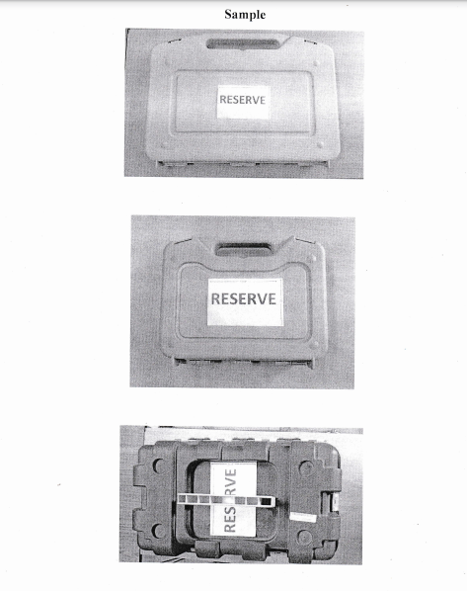
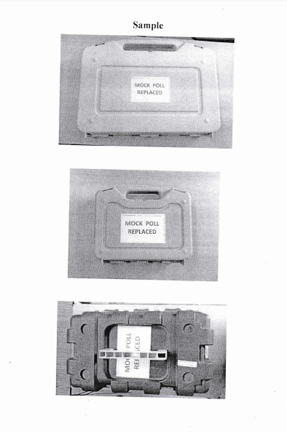

Slide 68
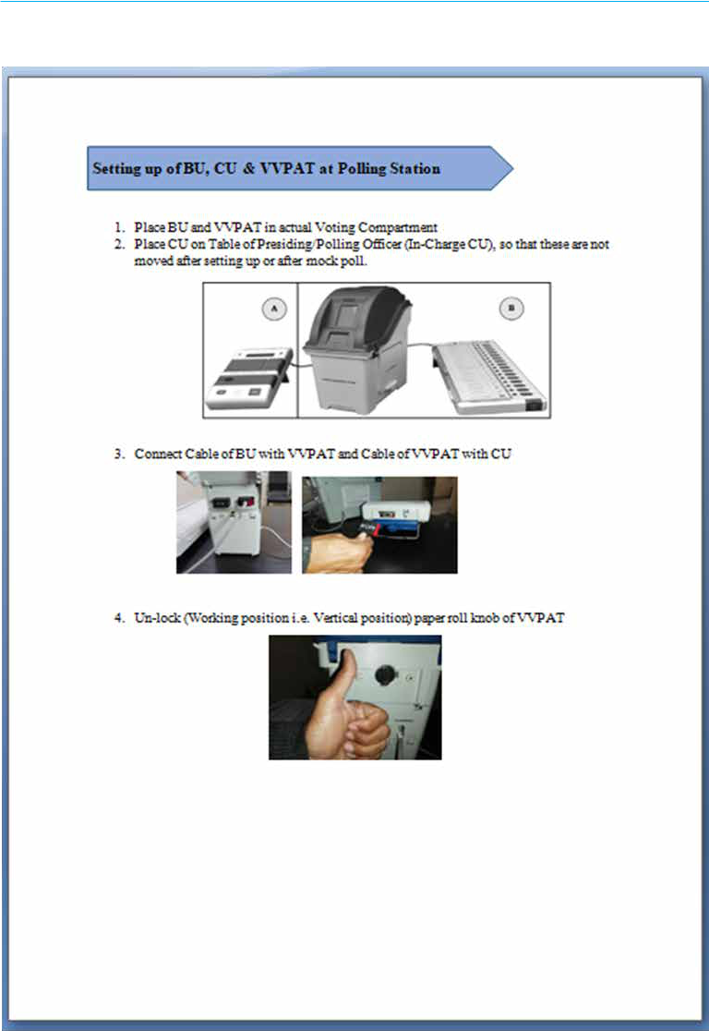

Slide 69
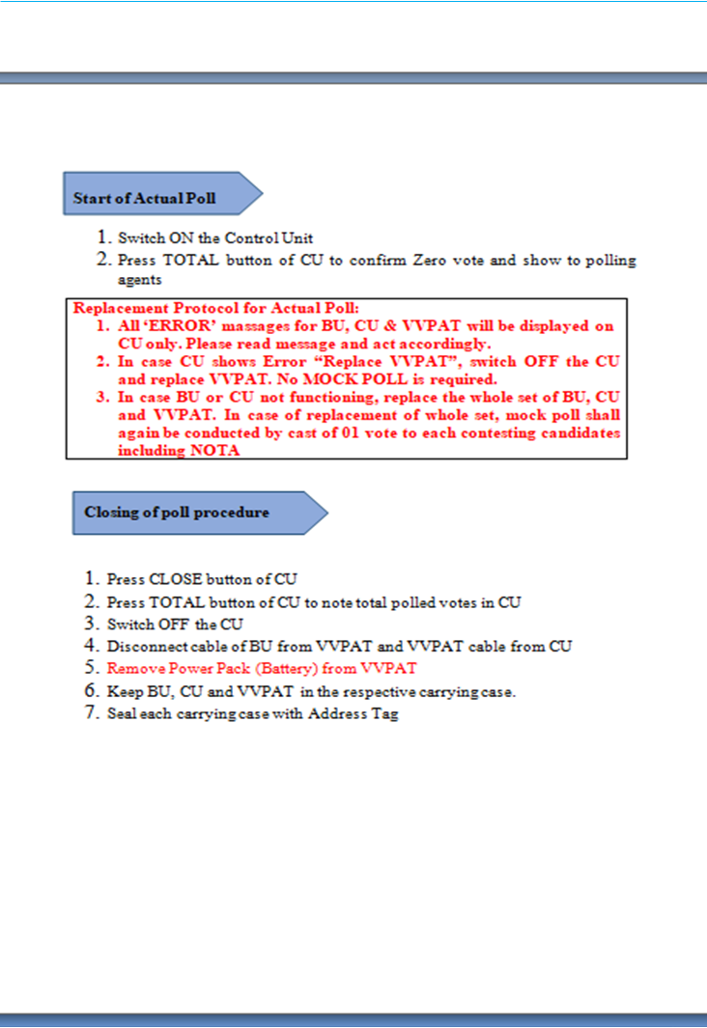

Slide 70
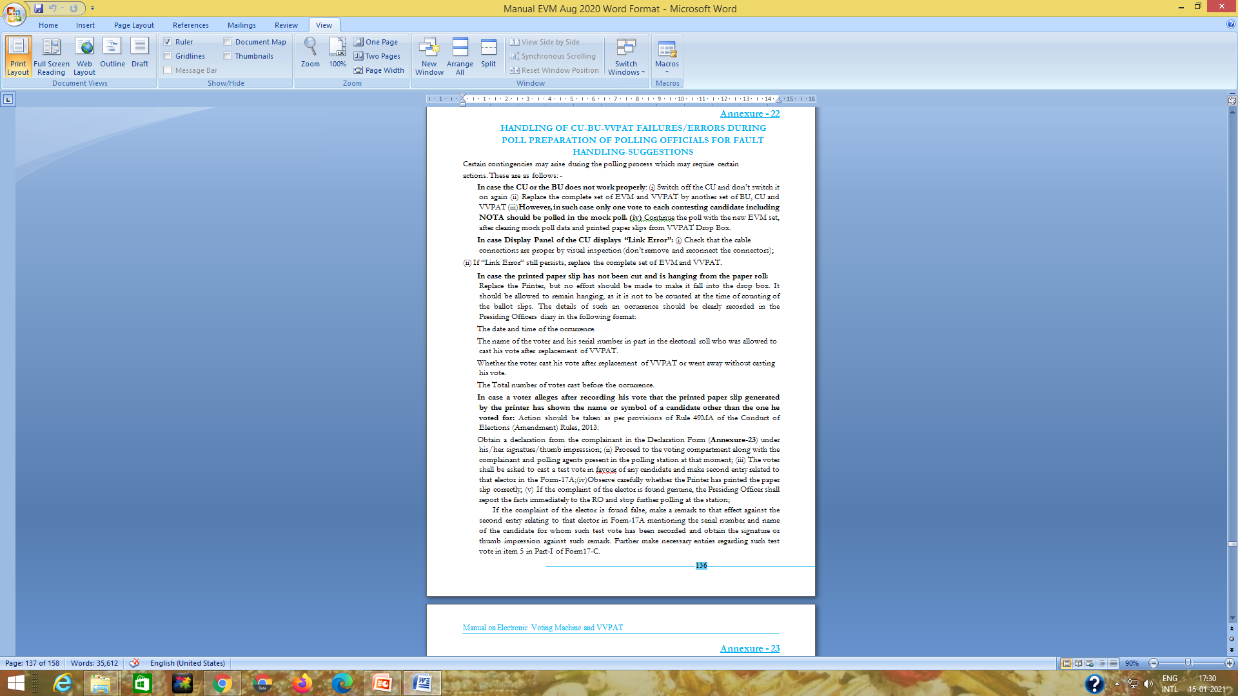

Slide 71
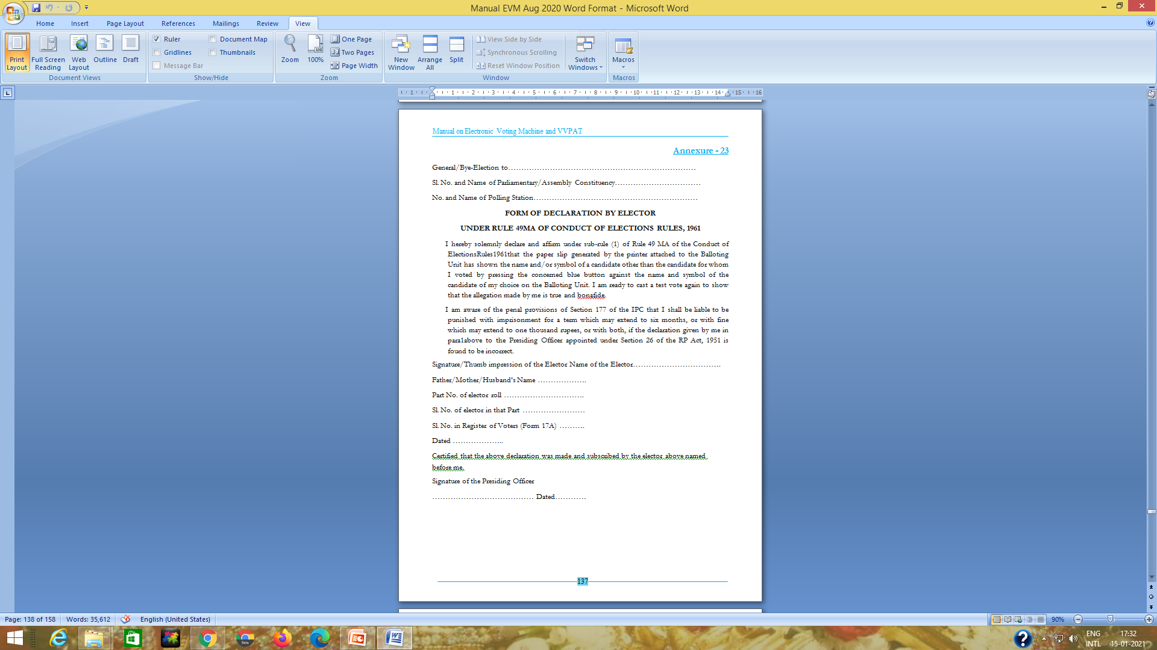

Slide 72
Change of Powerpack of CU
In case the Power Pack (Battery) of the control unit does not function properly or showing Low Battery, Presiding Officers shall take the following action:
i) Presiding officer shall immediately inform the same to the Sector officer for replacement of Power Pack of the control Unit. For this purpose, additional power Packs of the Control Units shall be provided to the Sector officers.
ii) Presiding officer shall replace the Power Pack of the control Unit in the presence of' the Polling Agents and Sector officer. PO shall again seal the Battery Section of the Control unit with thread and Address Tag and obtain the signature of the polling agent on the tag.
(iii) Presiding officer shall submit a report in the Format attached with the Commission’s letter No 51/8/7/2020-EMS dtd 25.08.2020 (i.e. part-III of the Presiding Officer's Report).

Slide 73
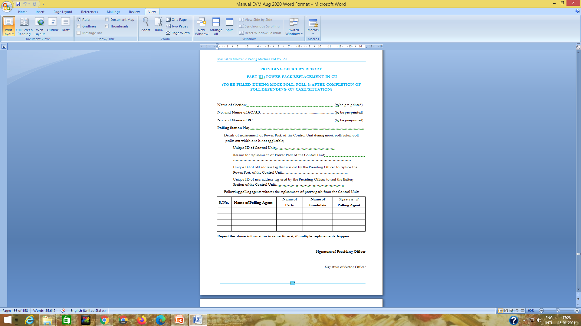

Slide 74
COMMENCEMENT OF POLL
Pr. O to read out provisions u/s 128 of R.P. Act, 1950 about maintenance of secrecy of voting
Pr. O to make a declaration in prescribed form about commencement of poll & sign & obtain signatures of polling agents present
If the preliminaries are not over, admit 3 to 4 voters at the hour fixed for commencement of poll
Send/sms a report on commencement of poll
Please remember if commencement of poll gets delayed by more than two hours, re-poll will be announced by the ECI
Demonstrate to the polling agents that the marked copy of the electoral roll does not contain any entries other than PB & EDC;
Demonstrate also that the register of voters (Form-17A) does not contain any entry;
Tally time with the polling agents.
Before the first voter signs in Form-17A (Register of Voters), the Polling Officer-1 shall check with the Presiding Officer and record in ink in Form-17A that "Total in the Control Unit checked and found to be zero".

Slide 75
Poll
    Regulation of entries at PS
    Role of CPF at PS
    Entry of Media
    Duties of PP
    ED vote

Slide 76
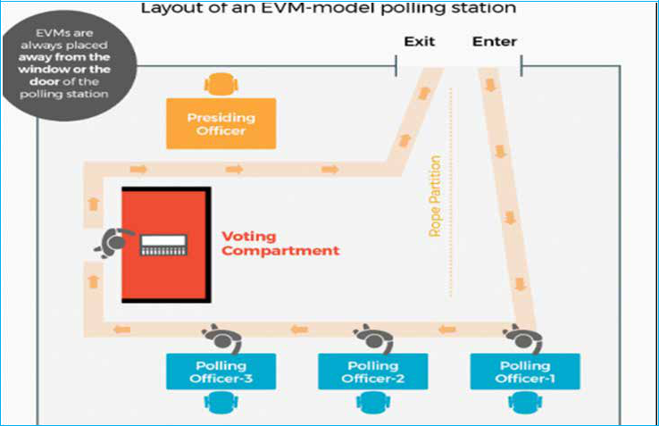
POLL DAY
Layout of polling station

Slide 77
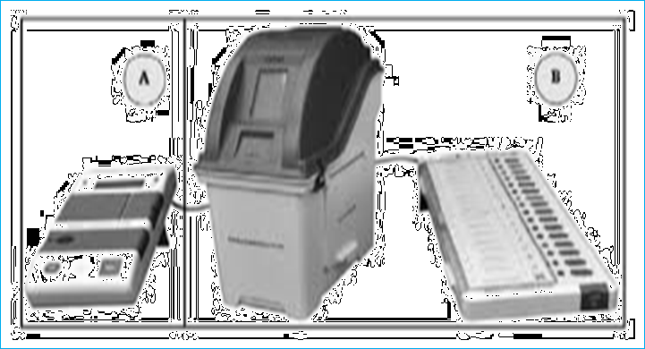
SET UP OF EVMs AND VVPATs
A. CU – Polling Officer (PO3)
B. BU + VVPAT – Voting Compartment

Slide 78
Poll Process: Regulation of Entry at Polling Stations
Persons entitled to enter, other than electors, are :
Polling Officers;
Candidates/Election Agents/one Polling Agent at a time;
Observers, Micro-observers, Persons authorized by ECI;
Child in arms accompanying elector;
Companion of blind, infirm elector;
Public Servant on duty;
Public Servant on duty does not normally include police officers. Similarly armed body guards of Candidates/ Election Agents/ Polling Agents are not also allowed, except they are covered under Z-plus security.
POLICE/CPF CANNOT ENTER POLLING STATION UNLESS DIRECTED TO DO SO BY PRESIDING OFFICER.

Slide 79
Role Of CPF at Polling Station on Poll Day
The CPF shall take positions in the assigned polling stations on P-1 day ( poll-eve day).
The CPF shall be primarily responsible for protecting the polling stations and regulating the entry inside the polling stations. In such cases one Jawan of the CPF shall position himself at the door of the polling station (either in static or oscillating mode) in order to observe the proceedings that are going on inside the polling station, as per the directions of Hon’ble Supreme Court.
‘Static guard duty in an oscillating mode’ is a situation when a building has multiple polling stations and CPF deployed is not sufficient to cover every polling station (door). In such a situation, the CPF Jawan on duty at the entrance of the polling station may be asked to oscillate from one polling station door to the other and keep an eye on what is going on inside these polling stations and report to the officer in-charge of the CPF or the Observer, if anything unusual is observed by him.

Slide 80
Presence of Media
Only those bearing Identity Cards issued by the CEO/ DEO.
Should not disturb voting process
Should not compromise secrecy of voting
Should stay for very short period only

Slide 81
Duties Of Polling Officers
Pr. O will be in overall charge of the Polling Station
1ST PO will be identifying the electors and will be in charge of marked copy of electoral roll
2nd PO will be in charge of indelible ink, Voters Register and, Voter’s Slip
3rd PO will be in charge of CU & preservation of voter’s slips.

Slide 82
Duties of First Polling Officer
1ST PO will be identifying the electors and will be in charge of marked copy of electoral roll
Identification of Electors:
All Electors who have been issued with EPICs, shall have to produce the EPICs to exercise their franchise;
Those who can not produce their EPICs can vote, provided their identity is established by alternative documents as will be allowed by the Election Commission.

Slide 83
Alternative Documents
For identification of voters at Polling Station, the Voter shall present his EPIC or any of the following identification documents as approved by the Commission: -
i. Aadhaar Card,
ii. MGNREGA Job Card,
iii. Passbooks with photograph issued by Bank/Post Office,
iv. Health Insurance Smart Card issued under the scheme of theMinistry of Labour,
v. Driving License,
vi. PAN Card,
vii. Smart Card issued by RGI under NPR,
viii. Indian Passport,
ix. Pension document with photograph,
x. Service Identity Cards with photograph issued to employees by Central/State Govt./PSUs/Public Limited Companies,
xi. Official identity cards issued to MPs/MLAs/MLCs and
xii. Unique Disability ID (UDID) Card, issued by M/o Social Justice & Empowerment, Government of India.
Voter Information Slip will NOT be used as alternative document

Slide 84
Duties of First Polling Officer
1st PO loudly reads out the Sl. No. & name of elector and verifies the Photo ID of elector;
When an elector is allowed to cast vote at the polling station, a line will be drawn, in red ink, diagonally across the box containing the particulars pertaining to that elector in the marked copy of the Electoral Roll.
Further, for easy verification and calculation of number of male and female voters, the serial number of the voter will be rounded off in the case of female voters.
Provide data on No. of votes polled to Pr.O from time to time. For this, usual practice is to keep a sheet containing consecutive numbers and crossing one by one as poll progresses

Slide 85
IDENTIFICATION OF VOTER
Minor discrepancies in EPIC relating to elector's name, father's / mother's / husband's name, sex, age or address shall be ignored and the elector allowed to cast vote.
Any discrepancy in the serial number of EPIC as mentioned in the electoral roll shall be ignored.
If an elector produces an EPIC which has been issued by the ERO of another Assembly constituency, such cards shall also be taken into account provided the name of that elector is in the electoral roll pertaining to the polling station where the elector has turned up for voting.

Slide 86
Duties of Second Polling Officer
Ensure that the electors put their full signature or LTI in the Register of Voters (Form 17 A).
Note the kind of Identification Document produced along with the No. of document produced, if given in the document, on Column 3 of Form 17A.
In case of EPIC holder, write EP and in case of other documents last four digits mentioned in the Column 3 of Form 17 A.
Issue voter slip

Slide 87


Slide 88

Duties of Second Polling Officer
Application of Indelible Ink
Inspect the elector's Left Forefinger and put a mark of Indelible Ink from the upper tip of the nail to bottom of the first joint in the form of a line as illustrated:

Slide 89
APPLICATION OF INDELIBLE INK
2nd PO will mark left forefinger from the tip up to the first joint with indelible ink;
When elector has no left forefinger, put ink on any finger on left hand starting from left forefinger, as applicable;
If elector has no left hand, put ink on any finger on right hand starting from right forefinger, as applicable;
If elector has no hand, put ink on extreme (stump) of hand as he possesses;

Slide 90
ISSUE OF VOTER’S SLIPS
It will be supplied in stitched bundles of 50 or 100,
After an elector’s left forefinger is marked with indelible ink and his entries are made in voter register, 2nd PO will issue Voter’s Slip;
Elector will be allowed to vote by 3rd PO on the basis and order of Voter’s Slips issued by 2nd PO;
All Voter’s Slips should be collected by 3rd PO from electors & preserved carefully and kept in separate cover;
Check again left forefinger of the elector,

Slide 91
RECORDING OF VOTES
3rd PO presses BALLOT button of the CU
Voter goes inside voting compartment for recording his vote;
If Voter is not familiar with voting procedure, he may be explained by the Pr.O the use of dummy cardboard model of the EVM in presence of the polling agents, but none should accompany the voter inside voting compartment;
If Pr.O needs to enter inside voting compartment during poll for any checking or so, when no voter is inside, he should ask or allow polling agents to accompany on all such occasions;
Tally number of votes polled periodically with CU & Register of Voters (Form- 17A)

Slide 92
Duties of Micro-observers
The Micro-observers are appointed to observe whether election process is being observed in a free and fair manner.
They will observe specially,
Mock poll procedure
Presence of polling agents & observance of ECI instructions with regard to them
Observance of entry pass system and access to Polling station
Proper identification of electors as per ECI guidelines
Identification and recording procedures for the Absentee, Shifted and Duplicate voter’s list (ASD list)
Application of indelible ink
Noting down particulars of electors as in register 17A
Secrecy of voting
Conduct of polling agents, their complaints ,if any.
He will make report to the Observer as will be asked to do so.
PrO not to seek any instruction from MO. If required ask Sector Officer or any Magistrates visiting the polling station

Slide 93
Plz. Note
Preparation of Pr.O’s report I in format.
Use of Dummy Cardboard Model of EVM for explaining the voting process by Pr.O to any voter who asks for help or expresses his inability to vote using EVM
PRO & other polling officers not to frequent voting compartment that may give scope of complaints
Time to time inspection of the BU in presence of all polling agents( with no voter)
Declaration form to be used by voters complaining on use of VVPAT.
Blind voters may vote by using braille system in the EVM

Slide 94
Procedure for ED vote
Obtain signature of person producing the EDC on the EDC (Form 12B). He must carry EPIC/Alternative Document for Identification.
Have the name and electoral roll details as mentioned in the EDC entered at the end of the marked copy along with electoral particular details
Each such entry should be serially numbered consecutively after the last sl number of entries in the relevant part of the roll (supplement 3).
EDC to be retained by PrO
Noting in 17A:
  -Roll details <Sl No>/<Part No>/<Assembly Constituency No>; eg.- 487/25/12- Alipurduar
  Remarks- “EDC Voter”
All EDCs produced to be kept in a packet to be returned at RC

Slide 95
Election Duty Certificate
  Who are entitled- All persons enrolled in electoral roll of the Assembly constituency
Filling up of Form 12A: Name - Part and Sl No –
    Search engines available at training centre OR
    WB<>EC<>EPIC Number and SMS to 51969
    Also write the following on 12A carefully
      PIN No -EPIC No - Mobile No
Submission of 12A- To be submitted in the drop box at the Postal Ballot Counter
12A with wrong roll details is liable to be rejected
Collect the ED certificate personally during second training producing identity details
EDC can also be collected from the DC on P-1 day
Once issued EDC is non refundable i.e the concerned elector cannot cast vote at the polling station where his name is enrolled.

Slide 96
Submission of 12A- To be submitted in the drop box at the Postal Ballot Counter
12A with wrong roll details is liable to be rejected
Collect the ED certificate personally during second training producing identity details
EDC can also be collected from the DC on P-1 day
Once issued EDC is non refundable i.e the concerned elector cannot cast vote at the polling station where his name is enrolled.

Slide 97
Extra Ordinary Situations
    Replacement of machines
    Test Vote
    Blind & Infirm voting
    Challenged vote
    Tender vote
    ASD voting
    Voting by Proxy
    Deciding not to vote
    Voting procedure violation

Slide 98
Replacement of EVM-VVPAT during Poll
In case the CU or the BU does not work properly during actual poll, replacement of the whole EVM including CU, BU and VVPAT is required. However, in such case only one vote to each contesting candidate including NOTA should be polled in the mock poll.
All mock poll data in CU and VVPAT paper slips from VVPAT must be removed by the Presiding Officer and the empty drop box verified by the Polling Agents.
The mock poll VVPAT paper slips, should be stamped on their back side with rubber stamp having inscription "MOCK POLL SLIP", thereafter they shall be kept in an envelope of thick black paper and must be kept in the special plastic box for mock poll and sealed with a pink paper seal.
In case of replacement of only VVPAT during actual poll, no mock poll will be conducted.

Slide 99
Replacement of EVM/VVPAT
During mock poll
During poll
Only the defective unit i.e CU or BU or VVPAT will be changed
BU/CU is defective
VVPAT is defective
The entire set i.e CU, BU and VVPAT will be changed
-Only one vote to each contesting candidate including NOTA should be polled in the mock poll.
Only VVPAT will be changed
-No mock poll will be conducted.

Slide 100


Slide 101
VVPAT Complaint by voter – Rule 49MA
In case a voter complains of wrong printing by VVPAT:
He will report to Presiding Officer.
Presiding Officer will take a declaration explaining that if found false he can be penalized.
PO will then record in 17A and permit him to cast a ‘test vote’ in presence of PO and Polling Agents.
If found false PO will record in 17A ( against whom the Test Vote has been cast)and 17C( in col 5.) so that test vote is not counted.
If found true then PO will stop poll and r eport to RO.

Slide 102
VOTING BY BLIND AND INFIRM VOTERS
Blind voters may vote through Braille system available in EVM. The procedure may be explained to him by Dummy cardboard EVM by Pr.O if necessary,
Or else a companion may be allowed of not less than 18 years of age;
No polling personnel shall act as companion
No person shall be permitted to act as companion of more than one elector at any polling station on the same day;
Get a declaration from the companion in this respect and also that he would keep secret the vote recorded by him on behalf of blind/infirm voter;
Keep a record of all such cases in Form 14A;
No polling personnel should act as a companion

Slide 103
As per the first proviso to sub-rule (1) of Rule 49N, one person cannot act as the companion of more than one elector. In order to facilitate the polling staff to ensure compliance of these provisions, application of indelible ink shall also apply to the companion. Indelible ink shall be applied on the right index finger of the companion. Marking of ink on the left index finger of the elector in such cases shall continue to apply as per the existing provisions.
Before an elector is permitted to take with him a companion inside the voting compartment, the right index finger of the companion should be checked to ensure that it is not already marked with indelible ink. If it is found to be already marked, such person cannot be permitted to be companion for the purpose of Rule 49N.
Companion shall leave Polling Station Location immediately after assisting an infirm/blind voter.

Slide 104
Voting by Blind and infirm Voters-instructions
Infirm voters who are capable of voting by herself/ himself by pressing the button of the candidate of his choice on the balloting unit of EVM shall be permitted authorized companion only up to Voting Compartment in the Polling Station, but not inside the Voting Compartment. This will apply in cases where the nature of physical infirmity is such that the elector needs assistance only for his movement and not for voting. The Presiding Officer has to take decision in such cases.
Sub-rule (2) of Rule 49N provides that the Presiding Officer shall keep a record of cases where electors record vote with the assistance of companion in Form 14A. This should cover all cases where the companion is permitted to go into the voting compartment with the elector to assist him in recording the vote. Cases where a companion only comes to assist the elector in his movement and does not go into the voting compartment shall not be included in Form 14A.

Slide 105
Voting by Blind and infirm Voters-instructions
While Scrutinizing of various documents such as the Form 17A, Presiding Officers Diaries etc., by the Observer and Returning Officer on the day following the day of poll, Form 14 A shall also be scrutinized to see whether there are unusually larger no. of cases of companions accompanying the electors in recording votes in any Polling Station, which may create suspicion about the fairness of poll.

Slide 106


Slide 107
CHALLENGED VOTES
Entertain a challenge from polling agent only after he deposits Rs. 2 in cash
Furnish a receipt to challenger;
Warn the person challenged about penalty for impersonating, enter his name and address in the list of challenged votes (form 14) and ask him to sign. If he refuses to do so, do not allow him to vote;
Summary inquiry: ask the challenger to adduce prima facie evidence. If challenger succeeds, ask the person challenged to produce evidence to rebut the challenge;
If challenge is established, hand over such person to police with a written complaint and return challenge fee after taking receipt in col. 10 of form 14 and counter foil of receipt;
If challenge is not established, forfeit the fee and write “forfeited” in col. 10 of form 14 and counter foil of receipt.

Slide 108
DECLARATION OF ELECTOR ABOUT AGE
If an elector appears to be below aged but his identity is otherwise established, take a declaration from him about his age in prescribed form;
Before taking declaration inform him about penal provisions of law for giving false declaration;
Prepare a list of such voters from whom the declaration is obtained. Also maintain a list of persons who refused to give declaration and have gone away without casting vote;
Keep all such declarations in a separate cover.

Slide 109
TENDERED VOTES
20 Ballot papers marked as tendered ballot paper on their back will be supplied per polling station;
Maintain complete record of electors issued with tendered ballot papers in form 17B;
Obtain signature or LTI of elector in col. 5 of 17B before issuing him a tendered ballot;
Elector will mark his vote through arrow cross mark inside voting compartment and fold the ballot paper, come out and hand over the same to the Pr.O;
Keep all tendered ballot papers and list in form 17B in separate cover;
Keep a correct account of tendered ballot papers (1) received in the polling station (2) issued to electors, and (3) unused and returned in item 8 of 17C part-I

Slide 110


Slide 111
Voting by voters from ASD list
Every elector, whose name appears in ASD list, shall have to produce EPIC for his/her identification or any one of the alternative photo identity documents permitted by the Commission.
The PrO shall verify the identification document personally and satisfy himself about identity..
A declaration shall be obtained from the ASD electors
ASD elector to be videographed(where videographer is attached.
the details should be properly registered in the register of voters in Form 17A.

Slide 112
The First Polling Officer shall inform the Polling Agents about the ASD elector who has come to vote by reading out his/her name loudly.
Thumb impression of such electors shall also be obtained in addition to signature against the column of "signature/thumb impression” of Register of voters (Form 17A).
The thumb impression shall be in addition to the signature even in the case of an elector who is a literate and can sign.
Presiding Officer shall maintain a record and give a certificate at the end of poll about electors allowed from ASD list

Slide 113


Slide 114
VOTING BY PROXY
There will be a list of CSVs (classified service voters) who have appointed proxies. Such a list will be attached at the end of Marked Copy of Electoral Roll:
Proxy will record vote on behalf of CSV in usual manner;
Mark middle finger of left hand of proxy;
Proxy is entitled to vote of his own in addition to vote as proxy, if he is registered elector of that polling station;
In case of proxy votes, Sl. No. of CSV as noted in sub-list should be recorded in the voter register;
For distinction, suffix PV in bracket in the voter register. For example write 1 (PV) in column 2 of the voter register.

Slide 115
REFUSAL TO OBSERVE VOTING PROCEDURE
If an elector refuses, after necessary warning by Pr.O, to observe voting procedure, do not allow him to vote;
If the elector is already issued Voter’s Slip, that should be withdrawn from him and cancelled;
Put a remark “Not allowed to vote – Voting procedure violated” in the remarks column of Voter Register and put full signature of Pr.O below that remark

Slide 116
ELECTORS DECIDING NOT TO VOTE
After recording in voter register, if an elector decides so, he should not be compelled to vote;
“Refused to vote” OR “Left without Voting” shall be noted in 17A Register and Pr.O should sign in full below that remark;
Signature/LTI of elector shall be obtained against such remark.

Slide 117
REPORTS OF PRESIDING OFFICER
1) PRESIDING OFFICER’S DIARY
  The PO is required to record the relevant events/proceedings as & when they occur in a diary as per annexure-XIV.
2) VISIT SHEET
  Fill up the information in the visit sheet as & when any officers visit the Polling Station .
3) ADDITIONAL REPORT by PO (16 points) is to be submitted to the observer/RO.
4) FILLING UP OF REGISTER OF VOTERS-
The PO should make required entries in the relevant columns of the above 4 documents at regular intervals.
5) Polling Agent Movement Sheet

Slide 118
Close of Poll
      17C
      Signatures of Polling agents
      Process
      Sealing of papers
      Sealing of machines
      Statutory/Non statutory/Third packet/4th packet etc. covers filling

Slide 119
Close Of Poll
Before five minutes for the scheduled hour of close of poll, go outside the polling station and announce that the intending persons to vote should come in a queue;
If poll continues beyond scheduled hour of close, make only one queue and distribute slips serially numbered and signed by Pr.O from the last person in the queue;
Continue poll till the person holding Sl. No. 1 slip. Collect all slips and destroy to prevent reuse;

Slide 120
Close Of Poll
Press CLOSE button of CU in presence of polling agents and replace the cap over it . Total no of votes recorded in the machine should be noted in item 5 of part-I of form 17C ;
Switch off the power and disconnect the BU from CU;
After completion of poll, the Presiding officer shall remove the power pack (battery) from VVPAT in the presence of polling agents. Only after removal of power pack (battery) form VVPAT. The carrying case of VVPAT shall be sealed in the presence of Polling agents.
Draw a line after last entry in Form 17A and certify “The serial number of last entry in Form 17A is ……….” & sign. Obtain signature of polling agents present. Mention time of poll closure.

Slide 121
The precise time of close of poll should be indicated in PrO’s diary (COL 20b) and 17A.
The precise time of closure of poll should be included in PrO’s declaration and it should be same as shown in CU.
Account of pink paper seal- no specific col yet given. Pls write separately under Col 7 (Paper Seal account) of PrO Diary eg.
Similarly in the address tag, also time of closure of poll shall be mentioned there by PrO. Polling agents of candidates should be allowed to sign on address tags, if willing
7 i) Number of Paper seal used | Green- 1 | Pink- 1
ii) Sl No. of paper seal used | AA009758 | dsf98729

Slide 122
ACCOUNT OF VOTE RECORDED
Prepare form 17C Part-I;
Total Elector assigned to PS= Total elector + Electors who have casted vote on basis of EDC
Total no. of votes recorded must be equal to the total no. of votes registered as per col. 1 of the register 17A minus no. of voters decided not to vote (as per remarks col. Of 17A) minus no. of voters not allowed to vote for violation of secrecy (as per remarks col. Of 17A); (2-3-4=6)
Supply attested copies of form 17C to all polling agents present irrespective of asking and take receipt. Better to supply after all sealing works relating to polled EVM and polled materials are over;
2 copies of 17C should be submitted in a separate cover at RC;
Pr. O to make declaration at the close of poll and get signatures of the agents present

Slide 123


Slide 124


Slide 125


Slide 126
Items to be signed by polling agents on Poll day
Pr.O’s Report I, II, III and Mock Poll slips envelope. (before commencement of poll and on subsequent replacement of EVM if any)
Green paper seal, Pink paper Seal, Spl. Tag- At the time of sealing CU after mock poll
Presiding Officer’s Declaration
  Part-I: before commencement of poll
  Part-II: on subsequent replacement of EVM if any
  Part-III: At end of poll
  Part-IV: After sealing of EVM
17A- In case of Test Vote is cast u/r 49MA
17A- after close of poll, below PrO’s signature
17C Part-I (after poll)
Movement sheet as and when applicable

Slide 127


Slide 128


Slide 129

Signature…………
Presiding Officer
Date…..

Slide 130


Slide 131
Affixing of Seal thereon by the Polling Agents:
The Polling Agents present at the polling station are also permitted to affix their seals, in addition to the seal of the Presiding Officer, on the envelopes and packets containing the following documents:
(a) The marked copy of the electoral roll;
(b) Register of Voters;
(c) Voters slips;
(d) The tendered ballot papers and the list of tendered voters in Form 17B;
(e) The unused tendered ballot papers;
(f) The list of challenged votes;
(g) The unused and damaged paper seals, if any;
(h) Appointment letters of Polling Agents; and
(i) Any other papers that the Returning Officer has directed to be kept in a sealed packet.

Slide 132
SEALING OF EVM and Polled Materials AFTER POLL
Switch off the CU & put in Carrying case and seal it at both ends with addressed tag with the help of seal of Presiding Officer;
Agents present should be asked to affix their seals;
Names of candidates/ polling agents who have affixed their seals on carrying cases of CU should be noted in the declaration at the close of poll;

Slide 133
PREPARATION OF PRO’S DIARY
Record relevant events as and when they occur at regular intervals;
Any lapse of writing diary at regular intervals is seriously viewed by ECI;
One of the important documents verified by the OBSERVER on the day after poll at the time of scrutiny;

Slide 134
Visit Sheet
Patrolling Magistrate, Sector Officer, Zonal Magistrate, DEO, RO, AROs and Election Observers, whenever they visit any polling station, shall make an entry in the VISIT SHEET kept with the Presiding Officers. Visit Sheet shall be deposited after end of poll along with Presiding Officer's Diary.
One of the important documents that will be verified by the OBSERVER on the day after poll at the time of scrutiny

Slide 135
    SEALING OFELECTION PAPERS IN PACKETS
The large White cover superscribed as “EVM papers” comprising
the unsealed envelope containing Account of votes recorded (Form 17C),
Unsealed envelope containing the Presiding Oﬃcer Report-I (Mock poll certiﬁcate), II & III and
Sealed Black envelope containing printed VVPAT paper slips of Mock poll shall be placed along with polled EVMs in the polled EVM Strong Room.

Slide 136
Special Counter at RC
for receiving EVMs/VVPATs and other documents from the specific polling-stations about which complaints had been received from political parties / candidates during the course of polling;
polling stations in which significant event such as violent-incidents, heated arguments with the polling personnel, clash between polling -agents, break-down of machines reported and where the EVM replacement had taken place .
SECOND PACKET (WHITE) : SCRUTINY DOCUMENTS (To be kept in Strong room other than EVM Strong room)
 | Envelope Set-02: Scrutiny Documents (Second Packet) | 2/1 Master Envelope for Scrutiny Documents Size (16”X12”) | Envelope No. 2/2 for Presiding Officer’s Diary, Size (10”X4.5”) | 1
 |  |  | Envelope No. 2/3 for register of voters (17A), Size (14”X10”) | 1
 |  |  | Envelope No. 2/4 for the list of blind and infirm electors in Form 14-A and the declarations of the companions (10”X4.5”) | 1
 |  |  | Envelope No. 2/5 for Visit Sheet (10”X4.5”) | 1

Slide 137
Six separate large packets:
Even if a statement or record to be mentioned in the statutory form or non-statutory form is ‘Nil’, such ‘Nil ‘remark should be marked on the concerned statutory form or non-statutory form and placed in the respective envelopes and packed in the large packets.
First packet (WHITE) - “EVM PAPERS COVER”
a)Envelope containing the account of votes recorded (Form-17C),
b)Envelope containing the PrO Report I (Mock-Poll Certiﬁcate), II & III
c)Black color Sealed Envelope containing Printed VVPAT paper slips of Mock Poll
Note: All the above election papers should be kept in unsealed white coloured master envelope (Envelope No: 1/1) and should be kept in the Polled EVM Strongroom.
In case of simultaneous election-
for assembly election,
one additional Master envelope for EVM Papers in pink colour,
one additional envelope for account of votes recorded (17C) in pink colour and
one additional envelope for Presiding Oﬃcer’s Report-I (Mock Poll Certiﬁcate), II & III in pink color and
one additional envelope for VVPAT paper slips of Mock poll in black colour for assembly poll EVM.

Slide 138
Second packet (colored WHITE)
-unsealed/sealed envelopes ( “SCRUTINY COVER”)
a)Unsealed envelope containing the Presiding Oﬃcer’s Diary
b)Sealed envelope containing the register of voters (17A)
c)Unsealed envelope containing Visit Sheet
d)Unsealed envelope containing the list of blind and inﬁrm electors in Form 14-Aand the declarations of the companions.
Note: All the above election papers should be kept in unsealed white coloured master envelope (Envelope No: 2/1) and Polling Station wise scrutiny cover required for scrutiny should be stored separately in a strong room other than Polled EVM strongroom having polled EVMs and VVPATs.

Slide 139
Third Packet ( White Color) – Statutory Cover
Sealed envelope containing the marked copy of the Electoral Roll and list of CSVs
Sealed envelope containing voter’s slip
Sealed envelope containing unused tendered ballot papers
Sealed envelope containing the used tendered ballot papers and the list in form 17 B
e) Sealed envelope including challenged vote in form 14

Slide 140
Fourth Packet (Non-Statutory Cover ) - Yellow
a)Envelope containing the copy or copies of electoral roll (other than the marked copy)
b)Envelope containing the appointment letters of Polling Agents in Form 10
c)Envelope containing the election duty certiﬁcates in Form 12- B
d)Envelope containing declarations by Presiding Oﬃcer
e)Envelope containing receipt book and cash if any, in respect of challenged votes
f)Envelope containing the declarations obtained from electors as to their age and the list of such electors who have refused to make declaration as to their age
g)Envelope containing unused and damaged paper seals and special tags
h)Envelope containing unused voter’s slips
I)Envelope containing Form of Declaration by elector under 49MA (Test Vote)
j)Envelope containing Form of Declaration by elector whose name is in ASD list
k)Envelope containing letter of complaint to SHO

Slide 141
Fifth Packet (Brown)
a.Handbook for Presiding Oﬃcer,
Manual of Electronic Voting Machine and VVPAT,
instructions etc.
b.Used and remaining Indelible ink set
c.Used Stamp pad (Brown colour)

Slide 142
Sixth Packet (Blue colour)
a)Candidate Information Booklet
b)Other unused forms
c)Metal seal of the Presiding Oﬃcer
d)The arrow cross-mark rubber stamp for marking tendered ballot papers;
e)Cup for setting the indelible ink.
f)All the other items, if any, should be packed into the Fifth packet (colored Blue).

Slide 143
Each of the four smaller covers/packets to be included in the third packet marked “STATUTORY COVERS” should be sealed.
Envelope containing the register of voters (17A) to be included in the second packer superscribed as “SCRUTINY COVER” and should be sealed.
The other smaller covers/envelopes containing various non-statutory papers and items of election materials to be included in the fourth packets superscribed as “NON-STATUTROY COVERS” and may be prepared separately. It need not to be sealed except the cover containing the list of challenged votes in Form 14 in order to save time.
All these unsealed covers and the sealed cover, containing list of challenged voters in Form-14,should be simply placed in the respective bigger covers after tick marking at the top page of the bigger covers and signed by you.
These bigger packets need not be sealed; but may be properly secured by means of pins or thread so that the contents may be checked at the collection centre.
The third packet superscribed “Statutory Cover” should, however, be sealed by you after checking of the contents at the collection centre.

Slide 144
RECEIVING CENTRE

Slide 145
ভোটের সামগ্রী জমা নেওয়ার ব্যবস্থাপনা
AC বা বিধানসভা ভিত্তিক নির্দিষ্ট সংখ্যক পোলিং ষ্টেশন পিছু কাউন্টার তৈরি করে ভোটের সামগ্রী জমা নেওয়ার ব্যবস্থা হবে।
চেকলিস্ট অনুযায়ী বিভিন্ন মালপত্র জমা নেওয়া হবে।
যেই স্টাফ জমা নিচ্ছেন তিনি ভাল করে খুঁটিয়ে দেখে তবেই জমা নেবেন।
ওই পোলিং ষ্টেশনের মালপত্র ওই কাউন্টারেই জমা নেওয়ার কথা কি না
BU/CU/VVPAT সিল করা আছে।
EVM Receipt Register অনুসারে BU/CU/VVPAT এর নম্বর মিলছে।
EVM Receipt Register এ প্রিসাইডিং অফিসারের সই রয়েছে।
17C তে উল্লিখিত ভোটের সংখ্যার সাথে 17Aতে মিল রয়েছে।
প্রিসাইডিং অফিসারের ডায়েরি ঠিক ঠাক ভাবে পুরন করা হয়েছে এবং সেখানে VISIT SHEET জুড়ে দেওয়া হয়েছে।
পোলিং এজেন্টদের 17C দেওয়া হয়েছে।
মক পোলের ব্যালট স্লিপযুক্ত প্লাস্টিকের বাক্স খাম I

Slide 146
প্রিসাইডিং অফিসারের ADDITIONAL FORMAT REPORT জমা হয়েছে।
প্রিসাইডিং অফিসারের ডায়েরি- 1 কপি, সিল থাকবে না।
Form 17C- 2 কপি, 1 টি সিল করা অপরটি সিল ছাড়া
প্রিসাইডিং অফিসারের ঘোষণাপত্র বা DECLARATION-ANNEXURE VII – 1 কপি সিল ছাড়া
VISIT SHEET- 1 কপি সিল ছাড়া
PS-05A- 1কপি সিল ছাড়া
17A
16 PT OBSERVER REPORT
Pr.O’s Report Part 1 & 3 must. 2, 4, 5 (If applicable)
LOG SHEET OF CAMERA
POLLING AGENT MOVEMENT SHEET
FORM 14A

Slide 147
RC তে SPECIAL COUNTER
এই কাউন্টার গুলোর ওপরে নির্দিষ্ট পোলিং স্টেশনের নম্বর এবং নাম লেখা থাকবে
কিছু বিশেষ কাউন্টার থাকবে যেখানে সেই সব বুথের মালপত্র জমা পড়বে যেখানে
কোনো অভিযোগ জমা পড়েছে
গুরুত্বপূর্ণ কিছু যেমন হিংসাত্মক কোনো ঘটনা, EVMভাঙচুর ইত্যাদি ঘটেছে।
EVM/VVPATপ্রতিস্থাপন করা হয়েছে।
এই বুথগুলির জন্যে RO একটি পৃথক রেজিস্টার তৈরি করে রাখবেন এবং এখানে EVM/VVPAT সহ অন্যান্য নথি জমা নিয়ে যাচাই করে RO পর্যবেক্ষকের সাথে আলোচনার পরেই প্রিসাইডিং অফিসারকে অব্যাহতি দেওয়া হবে।

Slide 148
PS – 05 সেখানে পাঠাবেন যেখানে RO বলেছেন
Receiving Arrangements
PrO’s diary, 17C, visit slip, -- আলাদা করে বেঁধে নির্দিষ্ট ট্রাঙ্কে রাখতে হবে
মনে রাখবেন
Statutory covers গুলি সংগ্রহ করুন। সেখানে থাকবে :
Marked copy of E. Roll
Voter Register (17A)
Voters’ slip
Unused tendered ballot papers
Used tendered ballot papers

Slide 149
Receiving centre
ইভিএমের সি.ইউতে জড়িত স্ট্রং রুমে সিল করা 17 C এবং Mock poll certificates abd black envelope একটি কপি ।
ট্রানজিট স্লিপ রেজিস্টার সহ স্ট্রং রুমে বি.ইউ, সি.ইউ এবং ভিভিপ্যাট প্রেরণ করুন
পোলিং স্টেশনের পোল্ড সি.ইউ-বি.ইউ-ভিভিপ্যাটের সম্পূর্ণ সেট একই স্ট্রং রুমে রাখতে হবে

Slide 150
ভোটের পরে ইভিএম এবং ভিভিপ্যাটগুলির জমা নেওয়ার ব্যবস্থাপনা
মেশিনের প্রকার | স্টোরেজ | Force | মন্তব্য
A ও B ক্যাটাগরিগুলি স্ট্রংরুমে পোলিং স্টেশন অনুযায়ী স্ট্রংরুমের স্কোয়ারগুলিতে, পিএসের বি.ইউ, সি.ইউ, ভিভিপ্যাট একসাথে রাখতে হবে | অনুমোদিত স্ট্রংরুমে | এক প্লাটুন সিএপিএফ | মক পোল স্লিপ সহ সিলযুক্ত খাম এ & বি মেশিনের সাথে থাকবে
স্ট্রং রুমের আশেপাশে নয় C ক্যাটাগরি - Unpolled ডিফেক্টিভ (জেলা ওয়্যারহাউস এ) 2. D ক্যাটাগরি - রিজার্ভ অব্যবহৃত মেশিন - ওয়্যারহাউসে অ্যাসেম্বলি পার্টিশন করে | জেলা ওয়্যারহাউসে | ১/২ section | ত্রুটিযুক্ত এবং অব্যবহৃত মেশিনগুলি একই সময়ে সংগ্রহ করতে হবে।

Slide 151


Slide 152


Slide 153


Slide 154





ECINET
Mobile App
FOR
Presiding Officers
Download Mobile App from

Slide 155




PRO Module
of
ECINET App

Slide 156


What is PRO Module?
A Designed for ease — a simple and intuitive app that ensures Poll Day activities are completed with minimal effort (Polling Party arrival status, Mock Poll, Start Poll, Polling Trends and Close of Poll) on P-1 and Poll Day.

Slide 157


Prerequisites/आवश्यक शर्तें
Smart Phone with Android or iPhone
  Minimum Android Version : 8.0
  Minimum iOS Version : 15.6
PRO mobile number should be registered and mapped with PS
Valid recharge if Pre-paid with Mobile data and SMS Pack

Slide 158



Action items/ कार्य बिंदु
App for PROs to input Polling party arrival status, Mock Poll activity,
Start Poll, Two hourly Polling Trends and Close of Poll

Slide 159

User Onboarding Steps
RO (Returning Officer) will register all PROs from ENCORE
PRO Name, Mobile number and PS Number is mandatory
RO may bulk import through excel sheet in one shot
PRO Mobile number is unique in System
RO may also edit any details of PROs if required
Only registered PROs will be able to login in App
RO should add Poll party details SO(s) and PO(s)

Slide 160


Steps to use/ प्रयोग की विधि
Download & Install ECINET Mobile App from Google Play Store or Apple App Store only
Login with registered mobile number and OTP
After login, verify your details from Dashboard Name, PS Name, PS Number, AC Name
Verify Elector Count (M,F and TG)
Perform activity step by step

Slide 161






Role of Presiding Officer On P-1 & Poll Day
1
Polling Party
arrival status
3
Poll Start
Marking
5
Close of Poll
Perform Mock Poll
Activity
2
4
Polling Trends
(Voter Turnout)

Slide 162

PRO Dashboard Screen

Slide 163


Submit
Polling Trends
                PRO can start data entry for turnout from 09:00 AM
                PRO can update/edit data as many times as he wishes till 09:20 AM
                Data entered in subsequent slot should be more than previous slot

Slide 164




Close of Poll
Close of Poll button will be enabled after 5:30 PM Only
Few PS are allowed close of Poll after 3:30 PM
This data is very critical and should be same as 17C
Will generate the Index card using the data submitted on this screen

Slide 165


Close of Poll Correction
Presiding Officer may edit the Close of Poll entries multiple times between 5:30 PM and 12:00 midnight
No corrections are permitted after 12:00 midnight on Poll Day in Close of Poll entries
After 12 AM midnight PRO may see Close of Poll data in read only mode

Slide 166

Offline Mode Support
PRO App will work in offline mode as well
Data stored offline will be sync to server
Data stored offline will be transmitted to server through SMS

Slide 167




Offline Mode Support

Slide 168





Offline Mode Support
Data Synced
Offline
Pending data Sync

Slide 169

Validation Rules (COP)
1
Total Votes
recorded in EVM
=
Total Male + Total Female +
Total TG + Total Test Vote
Close of Poll M+F+TG should be greater than or equal to Maximum data entered in any of the slots.
2

Slide 170


Vernacular Language Support
Available in Vernacular languages
Select language as per your convenience!

Slide 171


Video Tutorial
https://www.youtube.com/watch?v=do_jMFvXPUE
https://youtu.be/pX1AZ0c7V70
Hindi
English

Slide 172

Plan for Field Testing
Sl. No. | State | Total AC | Poll Day | Field Testing in one ac with BLO from Actual PS | Field Testing in complete ac with BLO from Actual PS | Field Testing with PRO including Reserve
 |  |  |  | 23rd March 2026
 |  |  | 23rd April 2026 |  | 13th April 2026 | 15th April 2026
9 | West Bengal - Phase I | 152
12 | West Bengal - Phase II | 142 | 29th April 2026 |  | 16th April 2026 | 18th April 2026

Slide 173
Checklist for field Testing
Field Testing in One ac with BLO
Field Testing in complete ac with BLO from Actual PS
Field Testing with PRO including Reserve
Selection of the AC for testing
Training of BLOs
Preparation of BLO list for onboarding
SOP Distribution to BLOs
Onboarding of BLO in Test Environment from RO Login
Download and Login Verification of ECINET app by BLO in T-1 day
Training of BLOs
Preparation of BLO list for onboarding
SOP Distribution to BLOs
Onboarding of BLO in Test environment from RO Login
Download and Login Verification of ECINET app by BLO in T-1 day
Training of PROs
Preparation of PRO list for onboarding
SOP Distribution to PROs
Onboarding of PROs in Test URL from RO Login
Download and Login Verification of ECINET app by PROs in T-1 day
The BLOs should perform this activity from actual PS

Slide 174
Timeline for Testing (T)
Sl. No. | Activity | Date & Time
1 | User Onboarding of BLOs as PRO | (T – 1) Day
2 | Login and verification of Polling Station in PRO App- ECINET | (T – 1) Day
3 | Mark Poll party arrived status | (T) Day (8:45 AM – 09:00 AM)
4 | Marking of Mock Poll Status | (T) Day (8:45 AM – 09:00 AM)
5 | Marking of Poll Start Status | (T) Day (8:45 AM – 09:00 AM)
6 | Two hourly polling trends data entry for 9 AM, 11 AM, 1 PM, 3 PM and 5 PM Slot. | (T) Day (09:05 AM, 11:05 AM, 01:05 PM, 03:05 PM, 05:05 PM)
7 | Close of Poll data entry | (T) Day (After 05:30 PM)

Slide 175



Thank You

